Slide 1



Week 4, Video 1: The Pros and Cons of Emotion in Politics & Media
Our first “required listening” activity is this week and relates to these lecture concepts!
z
Notes:
Last week, you completed the “Required Listening: Screaming into the void” assignment that focused on outrage, media, and politics. I wanted to provide a little more information and context on that.

Slide 2


We’ve Talked About Being Ethical and Compassionate
But…What if I’m just angry sometimes?
It’s OK to have strong political attitudes and get emotional at times.
We are not superheroes. We are human.

Slide 3

Emotions Are OK;
Please Share Them
We all get big emotions at times.
We need to sit with emotions and reflect about why we have them.
Emotion should not be ignored or dismissed
In politics, activation emotions leads to more participation.

Slide 4
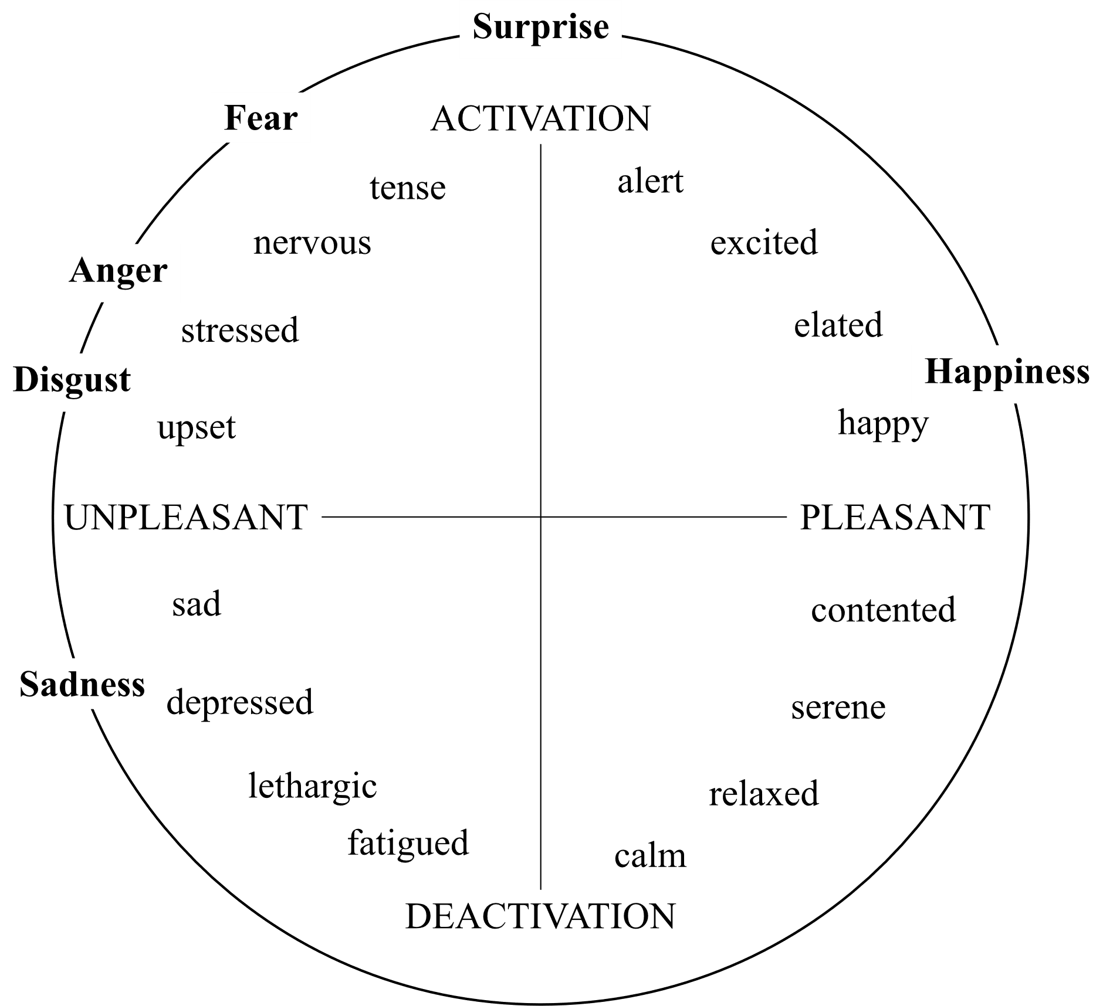
Emotions: Affect and Activation
Emotions help us determine our behaviors
Negative vs. positive affect (x axis)
Action potentials of behavior (y-axis)
Source

Slide 5


Strong Political Attitudes Are OK; Please Share Them
In short, being fearful/angry and being alert/excited are linked to political participation.
Strong political attitudes help democracy function.
Sharing your strong political attitudes help others see different perspectives.
Policy doesn’t change unless people share their strong political attitudes.

Slide 6


Avoid Tone Policing
What is “tone policing”?
Tone policing is a conversational tactic that dismisses ideas that are expressed in an emotionally-charged manner.
It's often used by people of high status/power to avoid engaging with people of lower status/power who are angry about being maltreated in society.
For example, telling someone who lost their job to calm down because they are angry.
Learn to sit with discomfort and listen rather than try to “police” their emotions.

Slide 7
How does tone policing differ from ethical and effective communication?
Tone Policing | Ethical and Effective Communication
Controlling the emotions of others | Managing our own emotions
Discourages anger expression by others | Sees anger and other negative emotions as normal and healthy
Regards emotional discomfort as an undesirable part of discourse | Regards emotional discomfort as a valuable part of discourse
Discourages discussion of topics that elicit strong emotional reactions | Encourages discussion of topics that elicit strong emotional reactions
Seeks to avoid conflict | Seeks to make conflict productive
Stifles dissent | Encourages dissent
Shuts down people with less privilege to avoid making the people with more privilege feel uncomfortable | Encourages people with less privilege to share their views no matter how it makes other people feel
Makes it harder for people to communicate their views to people with more privilege | Makes it easier to share their views to people with more privilege

Slide 8
How does tone policing differ from ethical and effective communication?
Tone Policing | Ethical and Effective Communication
Controlling the emotions of others | Managing our own emotions
Discourages anger expression by others | Sees anger and other negative emotions as normal and healthy
Regards emotional discomfort as an undesirable part of discourse | Regards emotional discomfort as a valuable part of discourse
Discourages discussion of topics that elicit strong emotional reactions | Encourages discussion of topics that elicit strong emotional reactions
Seeks to avoid conflict | Seeks to make conflict productive
Stifles dissent | Encourages dissent
Shuts down people with less privilege to avoid making the people with more privilege feel uncomfortable | Encourages people with less privilege to share their views no matter how it makes other people feel
Makes it harder for people to communicate their views to people with more privilege | Makes it easier to share their views to people with more privilege

Slide 9
How does tone policing differ from ethical and effective communication?
Tone Policing | Ethical and Effective Communication
Controlling the emotions of others | Managing our own emotions
Discourages anger expression by others | Sees anger and other negative emotions as normal and healthy
Regards emotional discomfort as an undesirable part of discourse | Regards emotional discomfort as a valuable part of discourse
Discourages discussion of topics that elicit strong emotional reactions | Encourages discussion of topics that elicit strong emotional reactions
Seeks to avoid conflict | Seeks to make conflict productive
Stifles dissent | Encourages dissent
Shuts down people with less privilege to avoid making the people with more privilege feel uncomfortable | Encourages people with less privilege to share their views no matter how it makes other people feel
Makes it harder for people to communicate their views to people with more privilege | Makes it easier to share their views to people with more privilege

Slide 10
How does tone policing differ from ethical and effective communication?
Tone Policing | Ethical and Effective Communication
Controlling the emotions of others | Managing our own emotions
Discourages anger expression by others | Sees anger and other negative emotions as normal and healthy
Regards emotional discomfort as an undesirable part of discourse | Regards emotional discomfort as a valuable part of discourse
Discourages discussion of topics that elicit strong emotional reactions | Encourages discussion of topics that elicit strong emotional reactions
Seeks to avoid conflict | Seeks to make conflict productive
Stifles dissent | Encourages dissent
Shuts down people with less privilege to avoid making the people with more privilege feel uncomfortable | Encourages people with less privilege to share their views no matter how it makes other people feel
Makes it harder for people to communicate their views to people with more privilege | Makes it easier to share their views to people with more privilege

Slide 11
How does tone policing differ from ethical and effective communication?
We will listen to another Required Listening activity about productive political conflict in the coming weeks.
Tone Policing | Ethical and Effective Communication
Controlling the emotions of others | Managing our own emotions
Discourages anger expression by others | Sees anger and other negative emotions as normal and healthy
Regards emotional discomfort as an undesirable part of discourse | Regards emotional discomfort as a valuable part of discourse
Discourages discussion of topics that elicit strong emotional reactions | Encourages discussion of topics that elicit strong emotional reactions
Seeks to avoid conflict | Seeks to make conflict productive
Stifles dissent | Encourages dissent
Shuts down people with less privilege to avoid making the people with more privilege feel uncomfortable | Encourages people with less privilege to share their views no matter how it makes other people feel
Makes it harder for people to communicate their views to people with more privilege | Makes it easier to share their views to people with more privilege

Slide 12
How does tone policing differ from ethical and effective communication?
Tone Policing | Ethical and Effective Communication
Controlling the emotions of others | Managing our own emotions
Discourages anger expression by others | Sees anger and other negative emotions as normal and healthy
Regards emotional discomfort as an undesirable part of discourse | Regards emotional discomfort as a valuable part of discourse
Discourages discussion of topics that elicit strong emotional reactions | Encourages discussion of topics that elicit strong emotional reactions
Seeks to avoid conflict | Seeks to make conflict productive
Stifles dissent | Encourages dissent
Shuts down people with less privilege to avoid making the people with more privilege feel uncomfortable | Encourages people with less privilege to share their views no matter how it makes other people feel
Makes it harder for people to communicate their views to people with more privilege | Makes it easier to share their views to people with more privilege

Slide 13
How does tone policing differ from ethical and effective communication?
Tone Policing | Ethical and Effective Communication
Controlling the emotions of others | Managing our own emotions
Discourages anger expression by others | Sees anger and other negative emotions as normal and healthy
Regards emotional discomfort as an undesirable part of discourse | Regards emotional discomfort as a valuable part of discourse
Discourages discussion of topics that elicit strong emotional reactions | Encourages discussion of topics that elicit strong emotional reactions
Seeks to avoid conflict | Seeks to make conflict productive
Stifles dissent | Encourages dissent
Shuts down those people who hold less power to avoid making others feel uncomfortable | Encourages people with less power to share their views no matter how it makes other people feel
Makes it harder for people to communicate their views to people with more privilege | Makes it easier to share their views to people with more privilege

Slide 14
How does tone policing differ from ethical and effective communication?
Tone Policing | Ethical and Effective Communication
Controlling the emotions of others | Managing our own emotions
Discourages anger expression by others | Sees anger and other negative emotions as normal and healthy
Regards emotional discomfort as an undesirable part of discourse | Regards emotional discomfort as a valuable part of discourse
Discourages discussion of topics that elicit strong emotional reactions | Encourages discussion of topics that elicit strong emotional reactions
Seeks to avoid conflict | Seeks to make conflict productive
Stifles dissent | Encourages dissent
Shuts down those people who hold less power to avoid making others feel uncomfortable | Encourages people with less power to share their views no matter how it makes other people feel
Makes it harder for people to communicate their views to people with more privilege | Makes it easier to share their views to people with more privilege

Slide 15

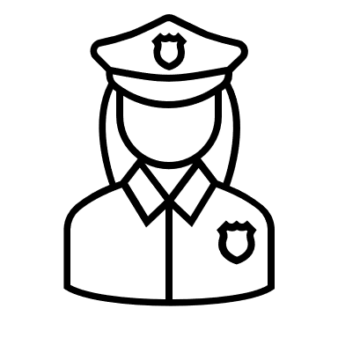
Anger expression can be productive for individuals and democracy.
Tone policing is hurtful to individuals, democracy, and productive conflict.
z

Slide 16

But negative emotions and anger also have downsides.
z

Slide 17

Concerns with Political Anger Following Divisive Political Campaigns
“Political anger lowers citizens’ trust in the national government, causing people to view it with hostility, skepticism and outright contempt.”
Anger fuels affective polarization.
“Consequently, voter anger causes politics to move beyond a competition of ideas and philosophies and into a zero-sum game in which each side’s gain is the other’s loss.”
“That weakens people’s commitment to the democratic norms and values that have long been the linchpin of the U.S. political system, such as tolerance and a respect for minority opinions.”
Source

Slide 18
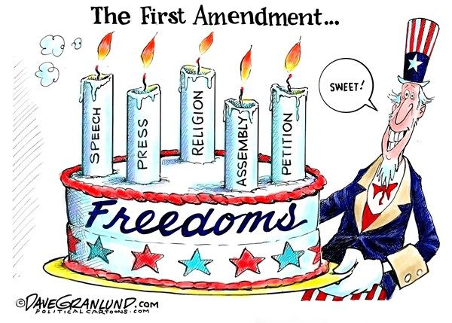
Remember, First Amendment Rights (and the Bill of Rights)
Respect for minority views is one of the major driving forces of the First Amendment.
And who is the minority opinion often varies by geography and time.
Note: minority views that express hate and violence toward others are not protected by the FA

Slide 19
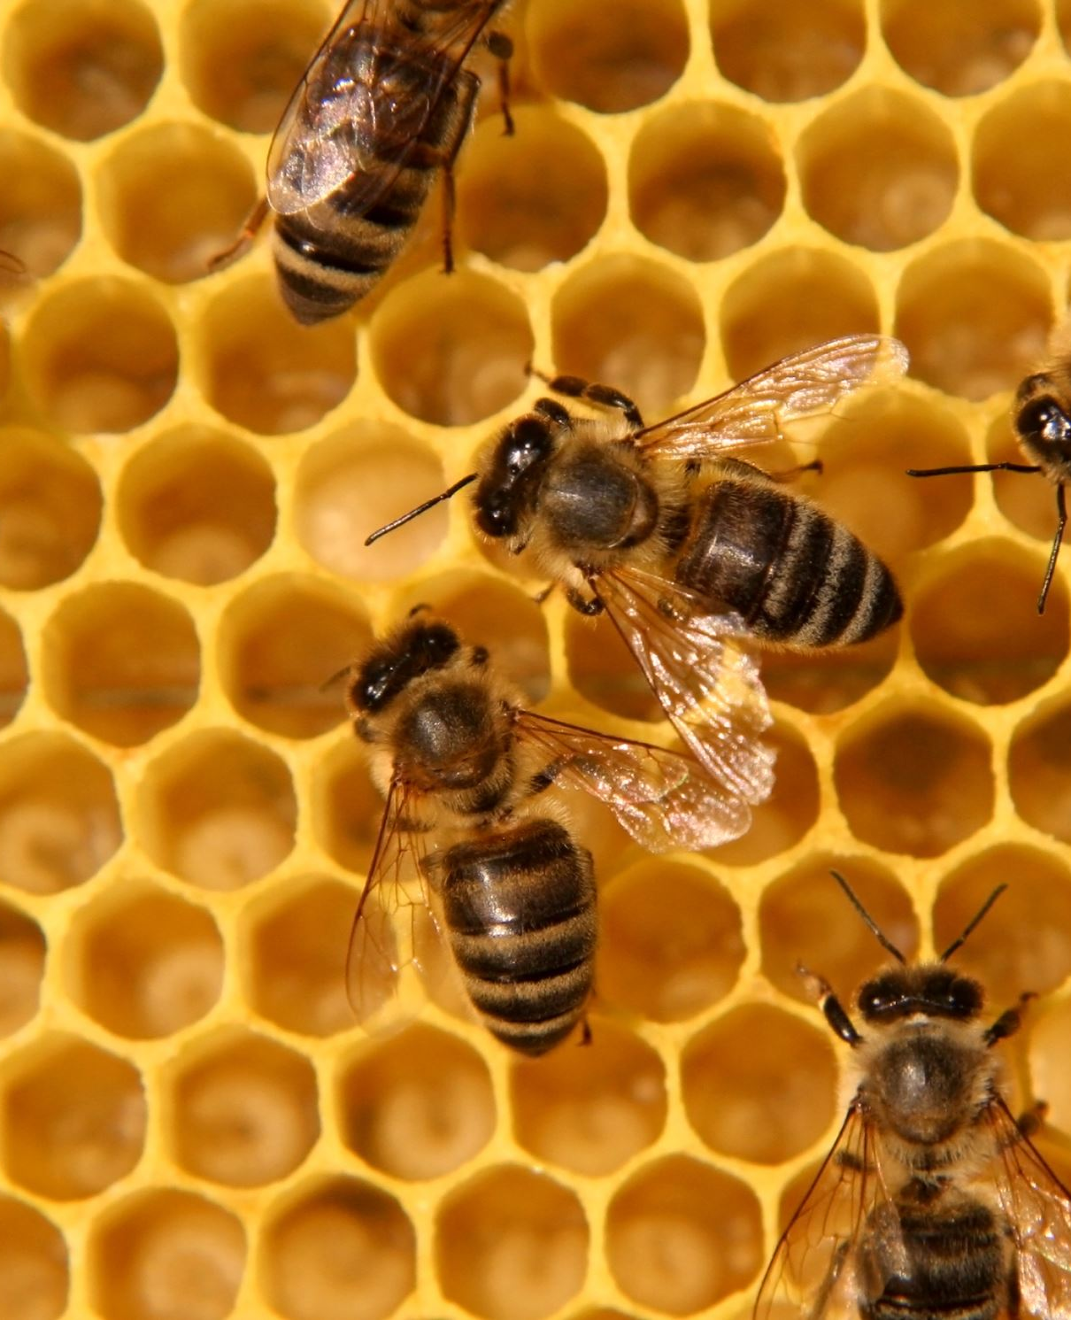
Emotions (like bees) can both build and sting.
It’s fine to hold strong attitudes and emotions.
We should learn and listen from strong emotions expressed by others.
Don’t let anger solely drive your political views.
Democracy thrives when we respect and listen to minority viewpoints.
Bee empathetic
Bee deliberative
Bee collaborative

Slide 20
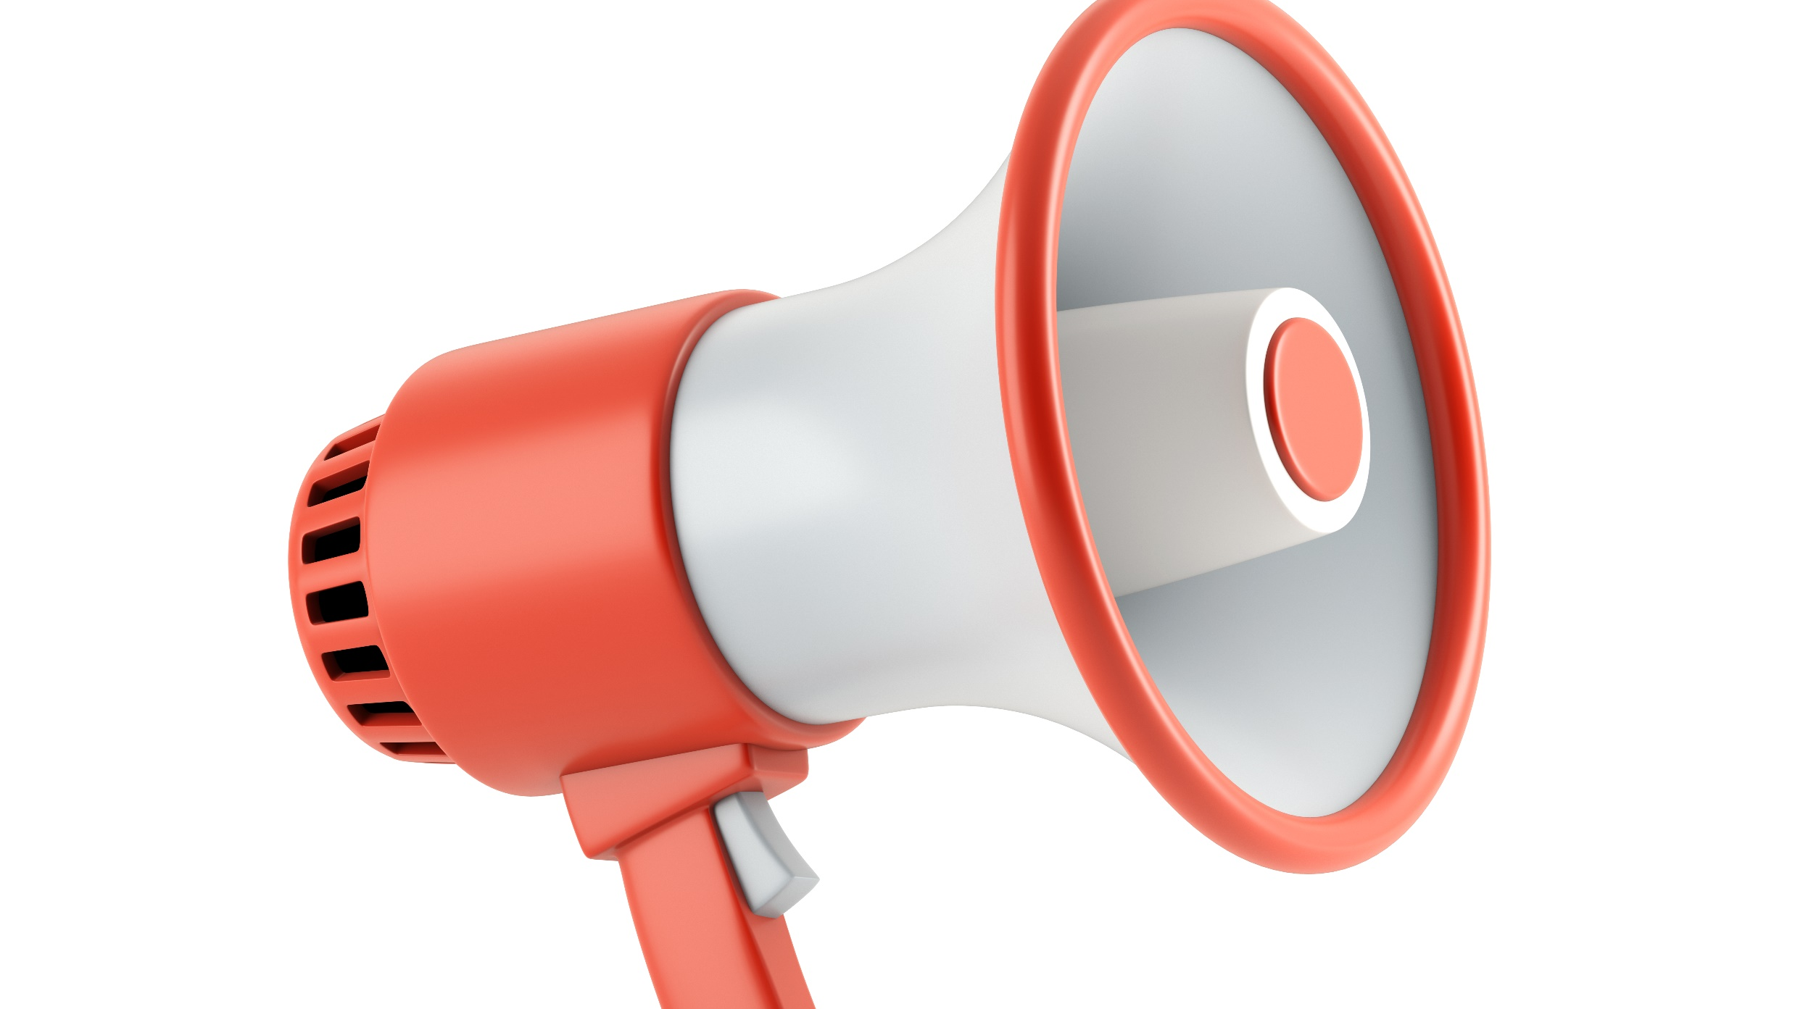
Required Listening: Screaming into the Void
Hidden Brain podcast examines social psychology and most of its sources are professors, researchers, writers, and other experts on the topics.
Listen to the 42-minute Hidden Brain podcast at "Screaming into the void“
  Outrage culture, politics, media, and social psychology
Choose at least three concepts from our video lectures, textbook, and short-writes that relate to this podcast, and describe their definitions and how they connect.

Slide 21
Political Socialization:
Political Attitudes & Our Genetics
Week 4, Video 2

Slide 22

Political Socialization
“Citizenship is not passed through genes.” (p. 149)
Democratic values, such as a commitment to peaceful transfer of political power, are taught to new generations.
Political socialization: “the way in which a society transmits political orientations—knowledge, attitudes or norms, and values—from generation to generation (Easton & Dennis, 1973, p. 59).

Slide 23
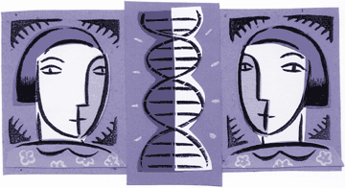
Political Attitudes & Genetics
Not a primary determinant of political attitudes, but a part of the mix
Twin studies show that genetics may account for nearly half of the variation in political attitudes
“To disentangle the effects of nature and nurture, researchers conduct a series of comparisons. They first determine how closely correlated the attitudes of identical twins are on a particular measure, say whether they identify themselves as strong conservatives, strong liberals or somewhere in-between. Then they do the same with fraternal twin pairs. Finally, they compare the two correlations.
If identical twins are significantly more alike in their views than fraternal twins, that’s strong evidence pointing to a genetic basis for the attitude.”
For more details, see Pew Research Center
There is not one “political gene.” There are thousands of genes that when combined with our environment and experiences, influence our social and political attitudes.

Slide 24
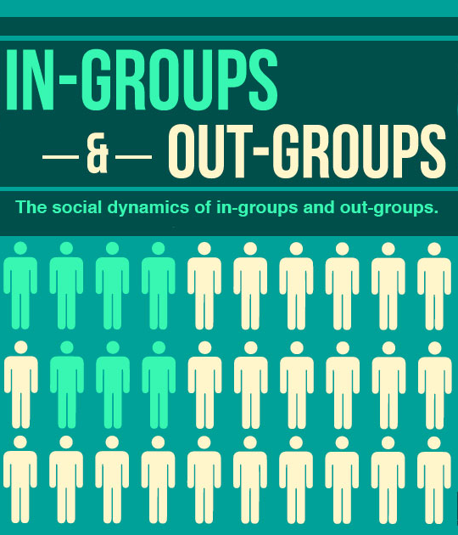
Political Attitudes & Genetics
Studies show people differ in their underlying fear dispositions to out-groups and there is a genetic link

Slide 25

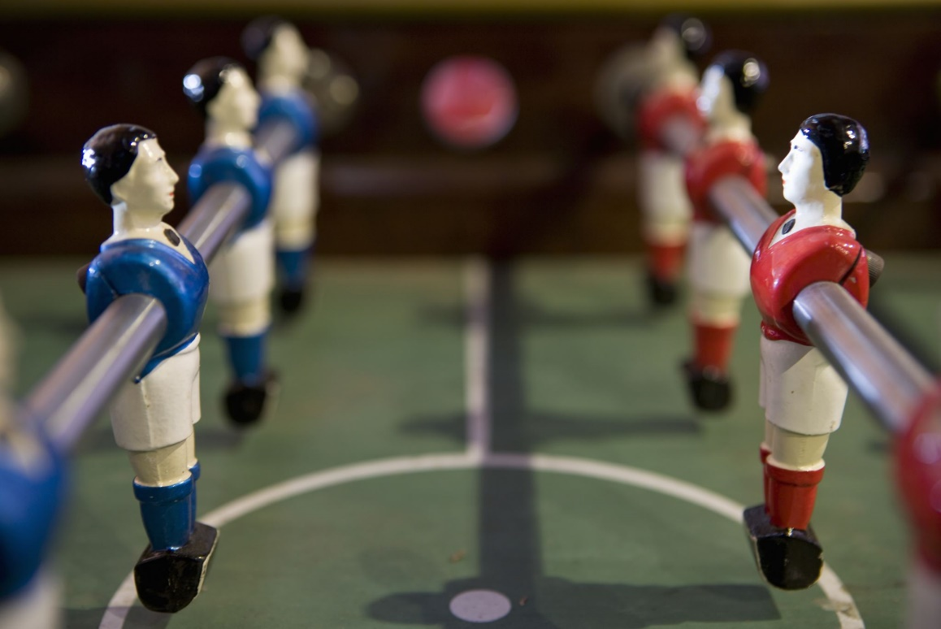
In-Group Loyalty vs.
Out-Group Skepticism
In-groups are people who we identify similarities with.
  We are Loyal to them.
  Perceptions of Trust, Expertise, and Credibility
Out-groups are people who we perceive as “other”.
  Skeptical and/or Hostile to them.
  Perceived wrong-doings and negative qualities are attributed to entire out-group

Slide 26
Political Attitudes & Genetics
Studies show people differ in their underlying fear dispositions to out-groups and there is a genetic link
Example: “Individuals with a higher degree of social fear have more negative out-group opinions, which, in this study, manifest as anti-immigration and pro-segregation attitudes.” (Hatemi et al., 2013).

Slide 27
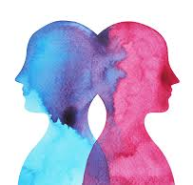
Political Attitudes & Evolution
Variation is Adaptation
These are NOT normative judgments about liberals and conservatives.
Evolutionary psychology approach to in-groups/out-groups, social fear, and adaptation vs. tradition:
It’s more advantageous to have a mix of genetic lineages who are more predisposed to out-group acceptance/approach and more predisposed to out-group fear/rejection
Some think this influence of genetics on political identity is a helpful adaptive strategy for humans

Slide 28
Short-Write for Week 4, Video 2: Genetics and political psychology
Listen, watch, or read the transcript to this 9-minute TED talk on “The psychological traits that shape your political beliefs”
Then, read the WaPo opinion article about the benefits of having genes and politics intertwined.
Then, complete the short-write activity: Consider there are many different political views in America.
Describe at least two benefits of the diversity of political attitudes to America. Please include references to the video lectures and/or reading materials. Consider what you just learned about political attitudes, genetics, evolution, psychology, and media.
Finally, consider the drawbacks of having genetics linked with political psychology – to what extent could this lead to people just taking a deterministic view of the world (i.e., saying “we can’t influence anyone anyways, so why bother” or perhaps justifying reasons for seeing some groups as superior to others).

Slide 29


Political Satire and Entertainment as Socialization Factors
Week 4, Video 3

Slide 30
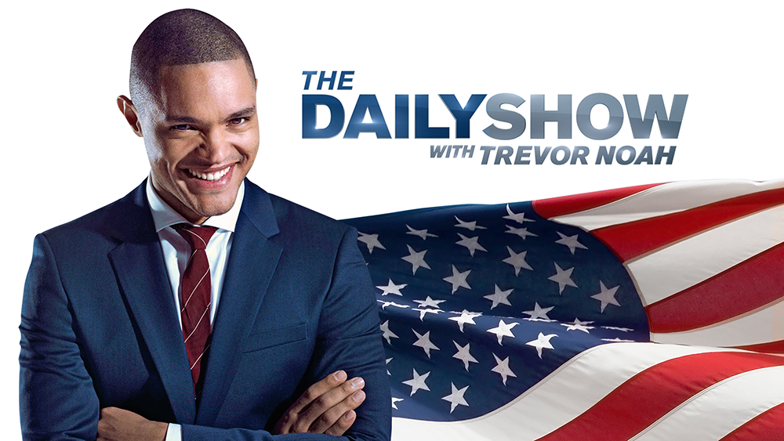
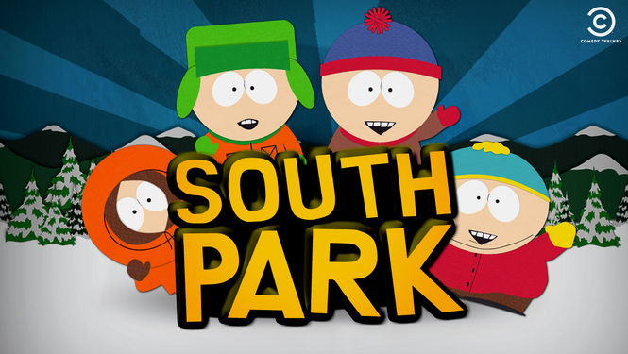
Defining and Understanding the Purpose of Political Satire
Satura – “full”
“A mixture full of different things,” Highet, 1962, p. 231
  Tragedy, comedy, distortion, surprise
“A playfully critical distortion of the familiar,” Feinberg, 1967, p. 19

Slide 31
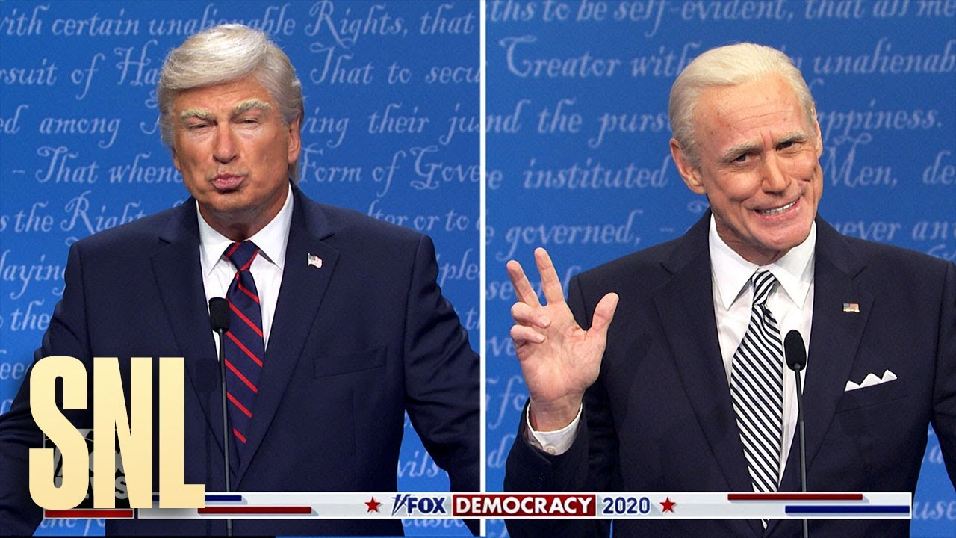
Defining and Understanding the Purpose of Political Satire
z
Goal: Persuasion through humor?
Assumed influence in history
Attacks on sociopolitical structure of society
A symptom of societal problems, not a cause
Doesn’t always suggest solutions to problems
Optimistic because it pleads with us to see the hypocrisies and return to decency

Slide 32
How can political satire and entertainment impact us?
z

Slide 33
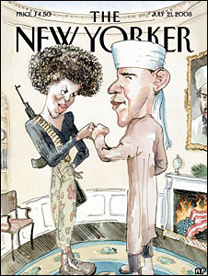
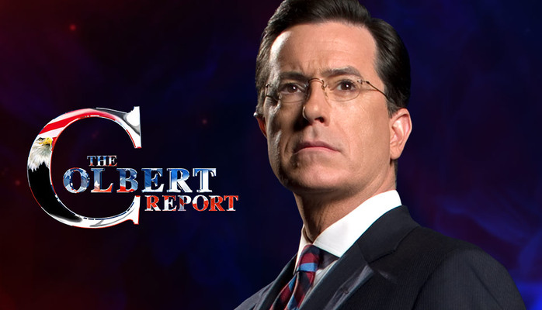
Ambiguity & Political Satire
We engage in biased information processing when ambiguous satirical messages are presented.
When the humorous message is not ambiguous, we are more likely to find satire and political entertainment aimed at “our side” to be offensive and outrageous.

Slide 34


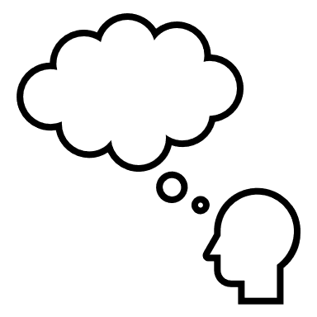
What Can We Gain From Political Entertainment?
Gateway Hypothesis: Political entertainment encourages us to search for news
More knowledge about current events
How to elaborate (think deeply) and counter-argue (see both sides)
We can elaborate better on real-world news topics when exposed to satire and humor about the same topic.

Slide 35
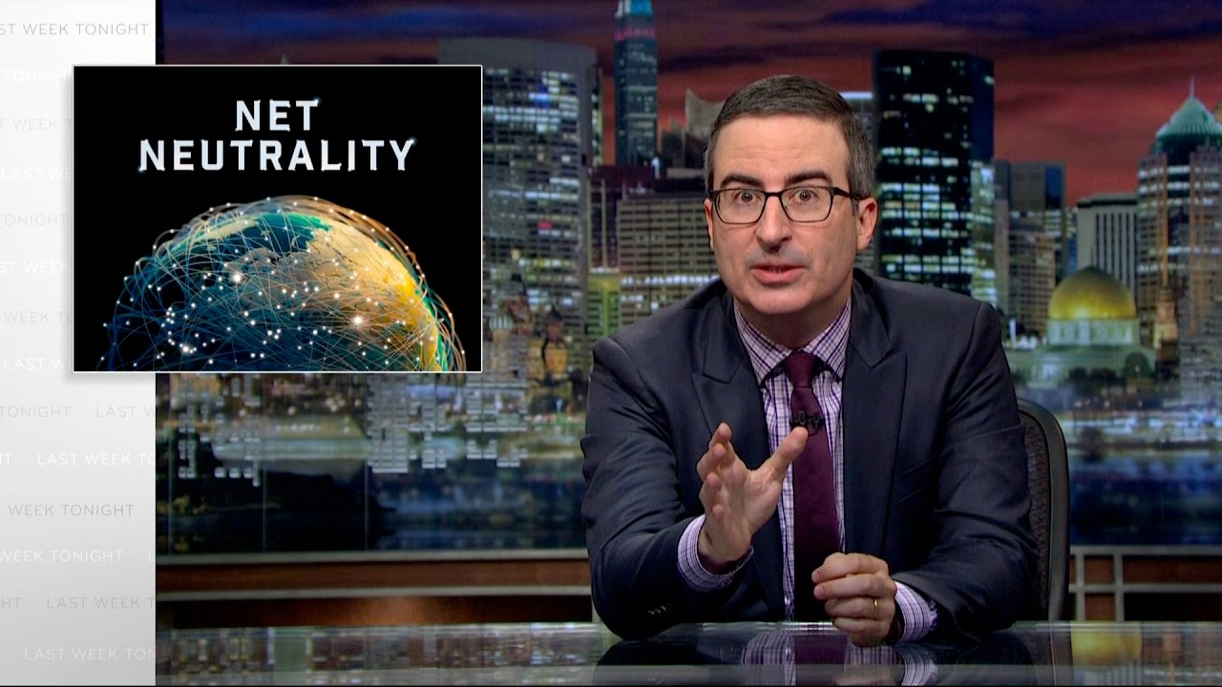
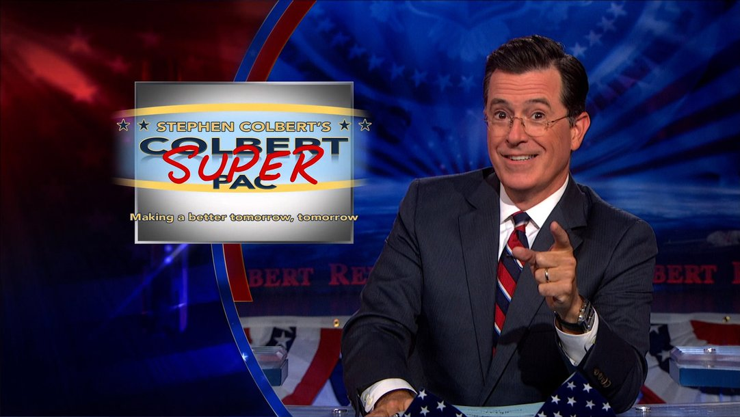
What Can We Gain From Political Entertainment?
More self-efficacy in politics
  “I am confident that I have the knowledge to participate in politics.”
Can provide action-oriented suggestions for how to change the perceived political, societal, economic, and cultural problems
Example: John Oliver’s long in-depth dives into complex issues
Example: Stephen Colbert educated viewers about Super PACs

Slide 36
Arguments Against Embracing Political Satire and Entertainment
Elitist, smug, and cynical
A display, a performance
Satirists question the motives of civic and political behavior.
Some evidence that we become more cynical and less trustworthy
Real politics is hard work and satirists teach us to “cop an attitude”

Slide 37
In the end, it’s complicated.
The impact of satire depends on the ambiguity and content of the satire, the person or group that the satire is directed at, and the audience members themselves.
In terms of political socialization…
Youth and liberal-minded people are typically more attracted to satire and entertainment than older and conservative-minded people.
Political satire and entertainment has impacted me A LOT in my political socialization.
To what extent has satire or entertainment impacted your socialization to politics or your generation’s socialization to politics?

