Slide 1

What is political (in)civility?

Slide 2
Why can’t we have civil conversations anymore?

Slide 3
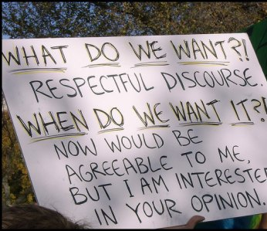
Lingering Questions
How can we mitigate political incivility?
How do we deal with political talk with combative others who are politically uncivil, offline or online?
Here are a few relevant topics before diving into a short-write on the topic of civility.

Slide 4
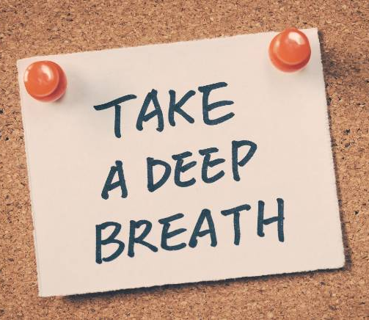
We can only control our communication.
Really, it works. Take a long, slow inhale for 6 seconds. Hold your breath for 4 seconds. Then take a long, slow, controlled exhale for 6 seconds. Research shows it lowers your heart rate, stress levels, and blood pressure.
Remember, it’s ok to have emotions.
How we use our emotions and how we see their value is important.
Too much anger diminishes our ability to critically assess information credibility → We are more likely to share misinformation when angry!
Avoid being combative in response.
Avoid tone policing and controlling others’ emotions.

Slide 5
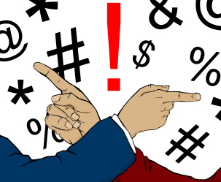
Use the Collective
“It’s uncomfortable for us all sometimes to learn information that seems against our beliefs.”
“We are all responsible for looking out for each other.”
“Me and you can still talk to each other even though we disagree. It should be our shared goal to keep talking rather than persuade each other.”

Slide 6

Respond to Dehumanization
Call out personal attacks that outright dehumanize others
Rhetoric or behaviors that overtly or subtly compares people to animals and insects is dangerous because of how we treat animals and insects – as “less than” human
Our world has a long history of dehumanizing others to arouse fear, anger, and hate in order to manipulate the masses.

Slide 7
Respond to Name-Calling and Personal Attacks
Call out personal attacks that denigrate or dismiss others
“It’s easy to call me racist, sexist, snowflake, sheeple, bigot, etc. But name-calling doesn’t get us closer to any productive solutions. Let’s talk about what issues you’re really dismissing and denigrating when you call me that name.”
“I won’t engage in a conversation if you name-call. I want to hear you and understand you because I value you. But if you can’t show me the same respect, then we will need to try this conversation again.”
Also – It’s really hard to stay calm in these scenarios! Take a deep breath.

Slide 8

Talk about Values;
Respect Autonomy
Respect autonomy by not aggressively trying to change their minds.
You can respect autonomy by asking questions that seek to understand.
“What do you value?”
“What experiences led you to that belief?”
“Help me understand your values. What do you see a key underlying reason for your belief?”
Try to identify commonalities in values in order to find connection.
If you have a common value but different conclusions, share your perspective on how the value leads YOU to a different conclusion.
Goal should be to communicate your values and perspectives to the best of your ability.

Slide 9

What’s “civility” anyways?
See Short-write for week 5, video 1
There are three brief NPR stories to listen to / read.

Slide 10
Short-Write for Week 5, Video 1
Topic: Political (in)civility
Goal: Understand different meanings of political (in)civility
Length: Two to three paragraphs
AFTER listening to the clips, define “political civility” in a sentence or two. I know it is a complex term, but just do your best with how you understand the term.
Write a sentence or two about how power, authority, and the status quo relate to the concept of political civility.
Write a paragraph about at least one new perspective/consideration of “political civility” that you learned from these stories. Again, there is no right or wrong answers here. I want you to show me your growth and consideration of others’ views and/or historical perspectives of civility that you learned. Feel free to discuss more than one perspective, too.

Slide 11

Why do we fall for misinformation?
Reasonable people are not immune to fake news and conspiracy theories!

Slide 12
A Scholarly Definition
“False or misleading information
designed to be spread”

Slide 13
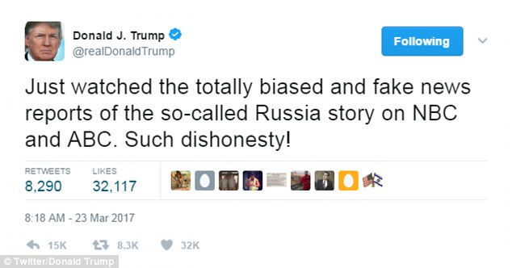
It’s A New Buzzword for Politicians and Partisans When…
a) A news story portrays partisans in a negative light.
b) Someone thinks a news story should not be on the agenda.
In 2018, President Trump had 225 tweets using the term “fake news” to describe mainstream and partisan news media.

Slide 14
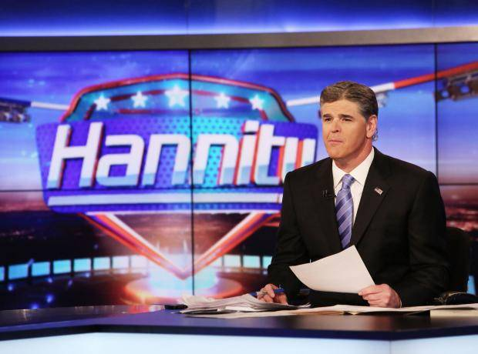

Partisan News Can Be Misinformation
Quick-Response:
What is a source of partisan news that you consume (or have consumed) that you have noticed misinformation or misleading information on?
Not necessarily fake news
Sometimes a type of misleading information
Facts Are Often Manipulated
Kernels of truth present, but…
Leave out key facts
Dramatize facts
Use information out-of-context
Denigrate credibility of sources that do not align with partisan identity

Slide 15
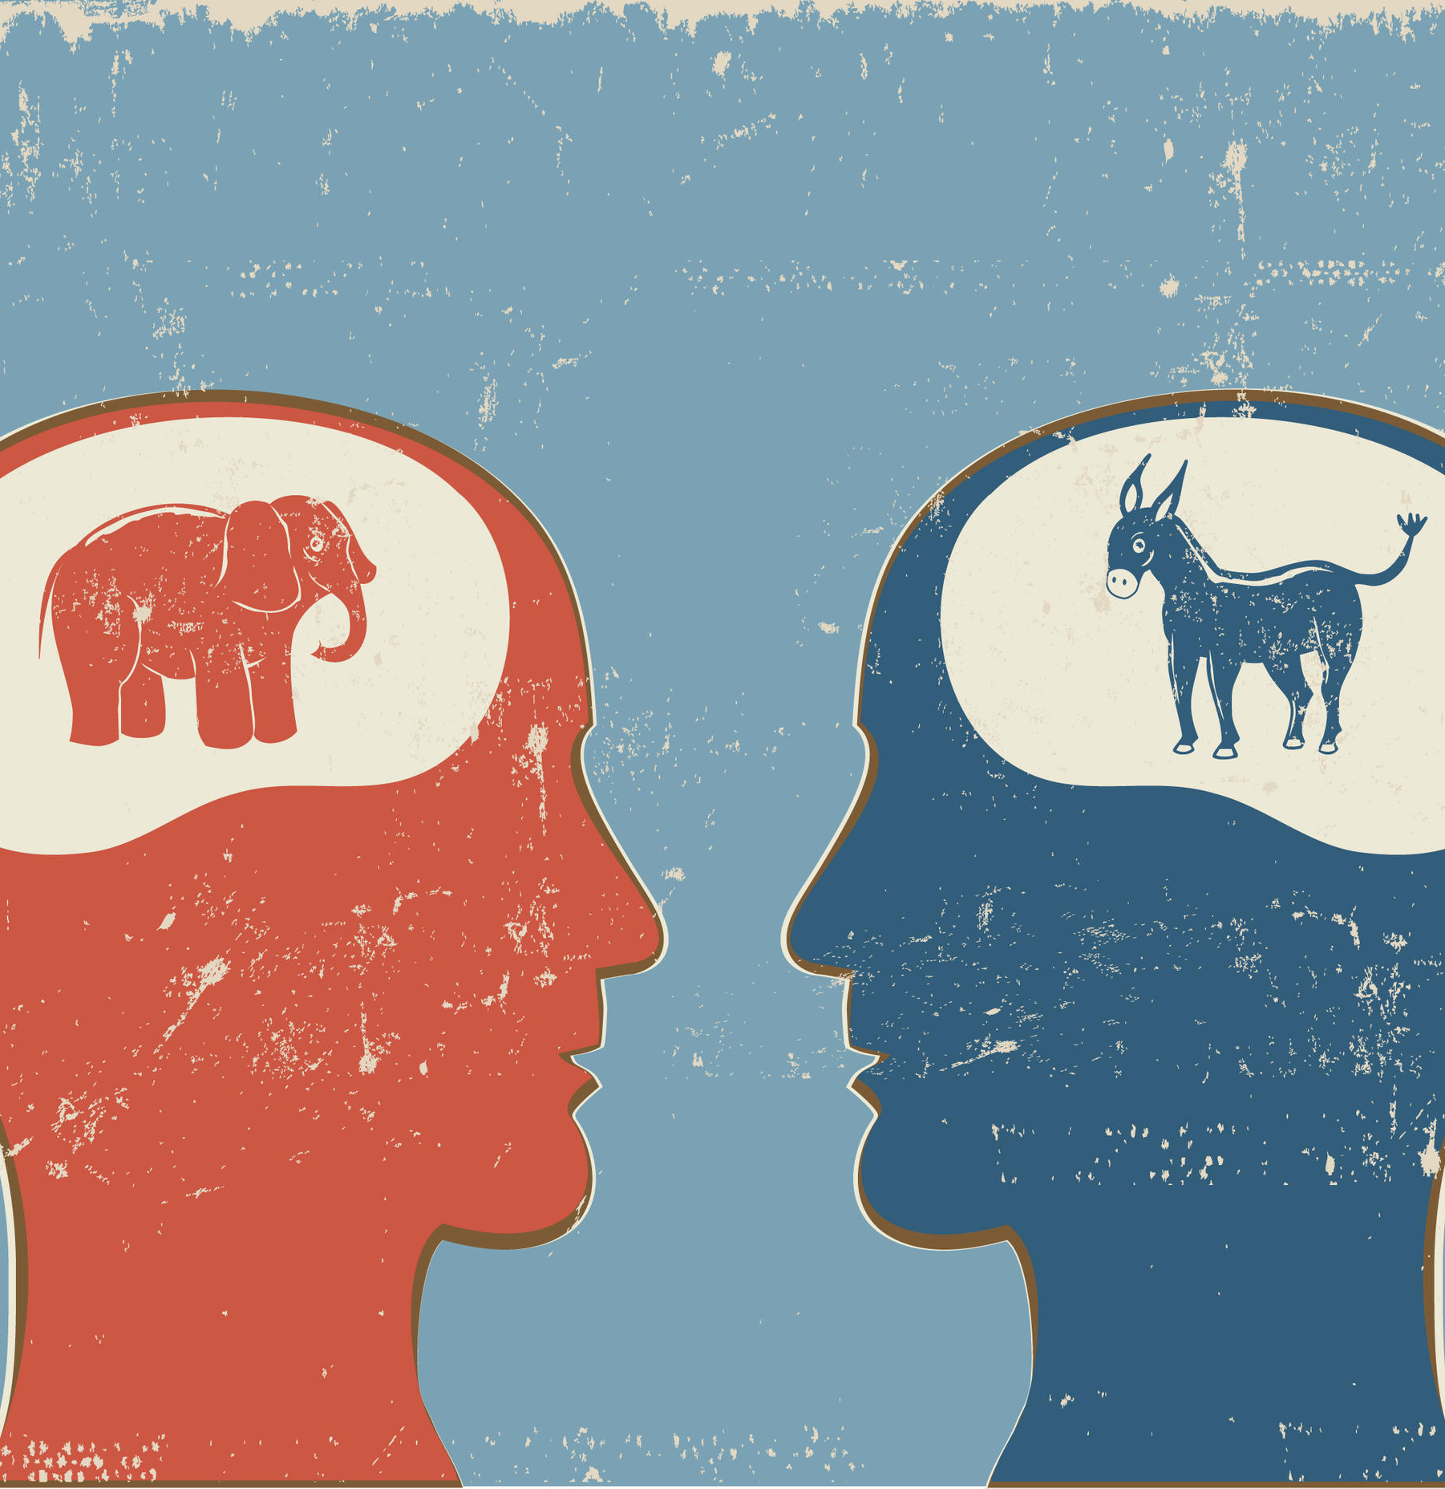
The Psychology of Fake News, False News, and Misleading Information
Let Me Preface This By Saying:
Psychological biases impact both conservatives and liberals.

Slide 16
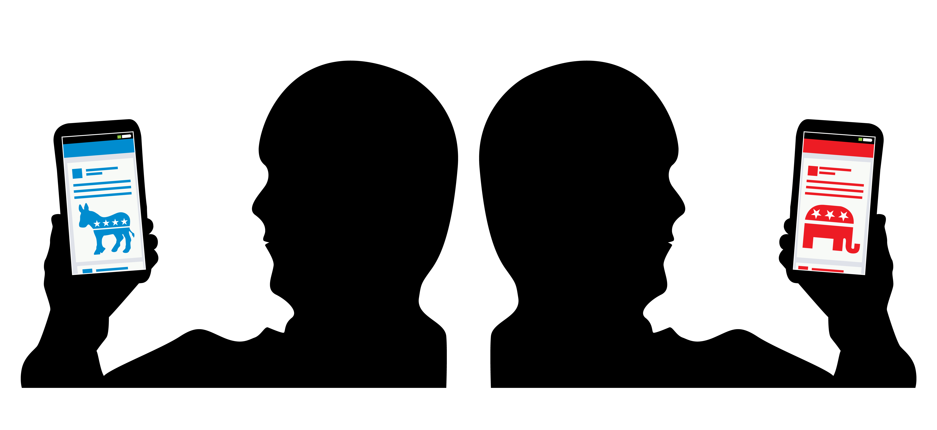
Selective Exposure
We favor exposure to news that confirms our pre-existing views.
Increases vulnerability of falling for fake news.

Slide 17

Social Networks Are Social,
For Better Or Worse
We let our guard down.
We trust our friends, even when the “source” is not truly that friend → problem of layered sources.
Emotions get in our way of critical evaluation.

Slide 18
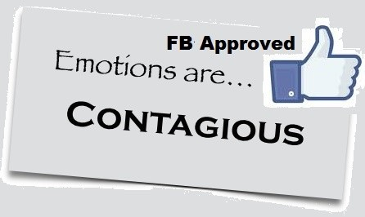
  Emotional Contagion
Anger linked with sharing fake news.
Angry people put their trust in information that makes their political side look good.
Angry people may argue that “it could be true”.
Angry people don’t always mind the information is fake or care they are being lied to.
And also highly approved by partisan news and every other social media platform.
Source

Slide 19
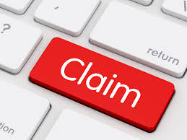
Claim Consistency
If a claim is consistent with other things you know:
You find that claim easier to understand,
Which makes the claim seem more truthful,
And discourages counterarguing and critical thinking
Source

Slide 20
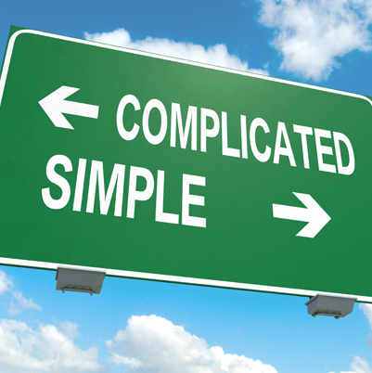
Importance of Coherence and Explanatory Power
“Occam’s Razor”
We stick with plausible and simple, even if evidence suggests otherwise.
Not an evidence-based decision-making strategy.
Source

Slide 21

Repeat It
Repeat It
Repeat It
Believe It
…Especially when it comes from people in our social networks
…And people who we know and trust.
Source

Slide 22

Motivated Political Reasoning
Quick-Response:
What political issue do you feel the most connection to?
Do you care about an issue?
Is the issue part of your identity?
Then Beware!
You’re more prone to emotional reactions to information.
It impairs your thinking.
It makes you vulnerable to fake and misleading news.
Make a mental note that THIS ISSUE is the issue that you need to be particularly attune to when consuming information. This enthusiasm and interest in this makes you prone to more emotional responses, which can impair your careful thinking about the issue.
Source
Notes:
Covington HS student sued WaPo for $250 million, claiming the “gist” of the WaPo article made him look bad. In June, judge dismissed lawsuit because the article described factual information and included various different opinions from sources, which are protected under the FA and the paper is not responsible for their opinions.
From: https://www.cbsnews.com/news/covington-catholic-high-school-twitter-takes-down-account-spread-confrontation-video/
The Twitter account that helped spread the initial video has been removed. The user -- @2020Fight -- claimed to be a teacher and advocate named Talia from California with a photo appearing to show Brazilian model and actress Natalia Cardoso.
In a statement, a Twitter spokesperson said "deliberate attempts to manipulate the public conversation on Twitter by using misleading account information is a violation of the Twitter rules."
"The lesson here is really to question, what is the genuine source of this content and how is it being framed? And then, how is that framing elevated by the news media that you're looking through?" said Louise Matsakis, who writes about cybersecurity and online culture for Wired.
There were some questions as to where the account originated from and we're told Twitter has every indication that it was a U.S.-based account. Natalia Cardoso has not commented publicly on the controversy.
House Intelligence lawmakers are reportedly asking Twitter about how the initial video came to be so widely viewed so fast.
From: https://www.washingtonpost.com/technology/2019/01/23/how-anonymous-tweets-helped-ignite-national-controversy-over-maga-hat-teens/
Researchers share that the majority hyper-partisan and inflammatory content is not spontaneous and viral.

Slide 23

avoiding misinformation

Slide 24

Just Because We Have These Psychological Biases and Fallacies…
Doesn’t Mean We Can’t Expect More Of Ourselves and Our Democratic Debate

Slide 25
Simple “Check-List” Strategies
Look at the domain name: “.com.co” are often fake
  Have you heard of the website before? Or is it something like RealNewsRightNow.com?
Triple check the story with mainstream news sources
Look for author attribution and author credibility/qualification statements
Check the “about us” tab and contact information
Check for mention of adherence to ethical standards of the Society of Professional Journalists (SPJ) or a place to report inaccurate information
Check AP News Fact Check, Snopes, FactCheck, PolitiFact
When you Google something, LOOK AT WHERE IT’S COMING from

Slide 26
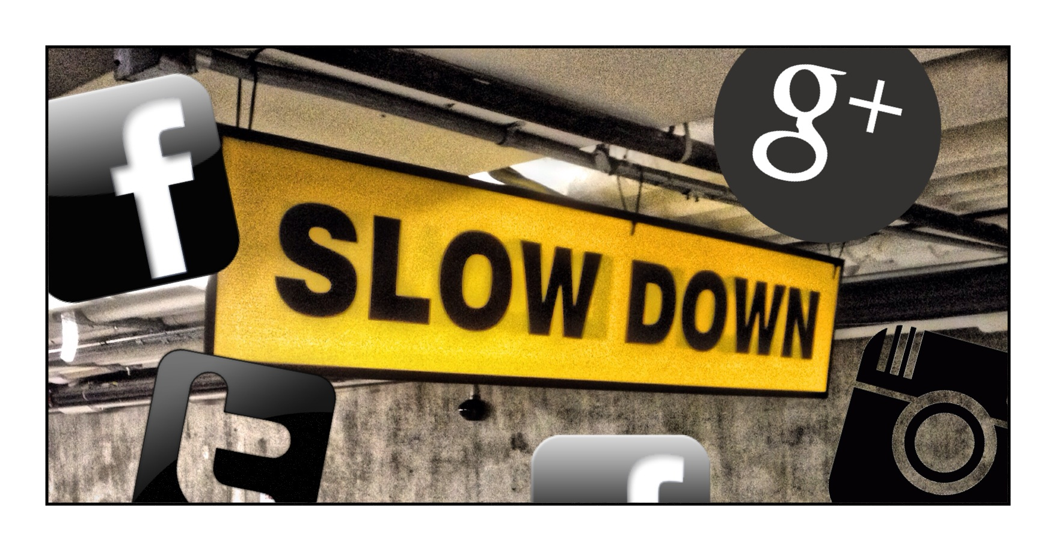
Slow Down For Curious (And Uncomfortable) Reflection

Slide 27

Become Critical Of Your Partisan Glasses
Partisans who are highly involved in an issue see neutral news coverage of that issue as bias against their side.
This perception is dependent on the reach of the news media outlet.

Slide 28

Disassociate Your Identity From Your Preferred Political Party and Politicians
When journalists provide critical coverage of our own preferred political party and politicians, we react emotionally.
We treat these attacks like attacks on our in-group and attacks on ourselves.
It feels so personal.
We may denigrate the source (e.g., the quality of journalists, the media outlet).
We may lash out with anger.
Keep these psychological biases in mind when consuming critical coverage.

Slide 29

Become Critical Of Your Emotional or “Gut” Reactions
50% of Americans trust their gut to tell them what’s true.
But people who don’t “fact-check their gut” are more likely to fall for conspiracy theories and misinformation.

Slide 30

Become Critical Of Your Partisan News Consumption
Mix up your news diet and your news discussion networks

Slide 31

Become Critical Of Your Partisan News Consumption
Partisans who consume information from a like-minded cable news pundit will estimate more factual content in the information than there actually is.
Because they have higher levels of perceived source credibility.
Opinion
Fact

Slide 32
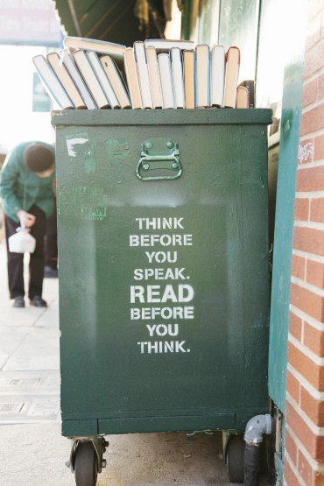
Your Responsibility
Before you share…
Recognize that you’re in a public space.
You have a civic responsibility to fact-check your postings.
The Final Exam will revisit some of these concepts.
Quick-Responses:
Type the name of one fact checking website.
Which of the following tips do you think is worth sharing the most with others about how to avoid misinformation?

