Slide 1

Week 13, Video 1: Data Cleaning
WyoCourses → Modules → Week 13 → Data Cleaning Steps

Slide 2
Cross tabulations: Chi-square
Week 13, Video 2
Chapter 15

Slide 3
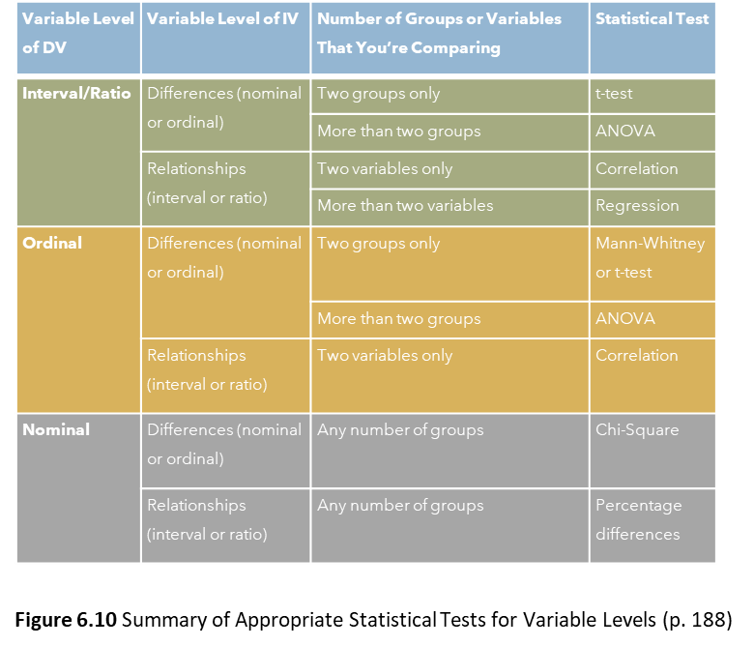

Slide 4
Basics of statistical reporting
For most statistical tests, you need to know three things:
Value of the specific statistic (ex., t-statistic, chi-square statistic, etc.) that SPSS gives you
Degrees of Freedom, which SPSS denotes as df
p-value, which SPSS denotes as “significance” or “approximate significance”

Slide 5
Chi-Square test
Statistic that lets you compare two nominal level variables
Strengths:
  Since any level of variable can be collapsed to a nominal variable, chi-square statistic practically can be used for any type of measure
  Easy to calculate the value by hand if you don’t have software available (we aren’t doing that though)
Example: Are income levels different depending on your employment status?
  Both income and education are measured as nominal or ordinal

Slide 6
Chi-Square Example
Go to “practice-assignment-data.sav” file.
Analyze → Descriptive Statistics → Crosstabs
Row should have the “income” variable
  The row should be the DV.
Column should have the “employment” variable
  The column should be the IV.
Go to Statistics → Select “Chi-square”
The results show that Pearson Chi-Square is 63.243, df = 44, N = 186, p = .03.
We write this up as:
To test whether employment status is related to income, a chi-square analysis was run. There were significant differences, χ²(df=44, N=186) = 63.24, p = . 03.

Slide 7
But where are the groups different?
A Pearson chi-square test is what is known as an OMNIBUS test – this means that it says a difference exists among the groups SOMEWHERE, but the test doesn’t say where.
The textbook gives one way to examine specific group differences: Running separate chi-square tests comparing each of the groups.
PROBLEM: This inflates the chance that you will have a type one error because there is a 5% chance that the null hypothesis (rather than your hypothesis) is correct for EVERY test you run
Another way to look for specific group differences is to use the column proportions on SPSS

Slide 8
But where are the groups different?
Go back to Analyze → Descriptive Statistics → Crosstabs
Row should have the “income” variable
Column should have the “employment” variable
Go to Statistics → Select “Chi-square”
Go to Cells → Select “Compare column proportions” and select “Adjust p-values (Bonferroni method)” box
  The adjust p-value box helps keep the .05 alpha level across ALL of the comparisons, not just for each individual comparison
Also in Cells → Select “Column” box under Percentages
  This shows the proportion of responses
Run the analysis.
Now, look at the crosstab box, there are a bunch of letters now.
  If the letters match, there are NO differences between the groups.
  If the letters are different, there are significant differences between the groups.
In this analysis, we see that the only differences anywhere in the employment groups and income is in that first row (less than $10,000)

Slide 9
Testing for effect size
Remember the concept of effect size: how substantial the significant result is
For chi-square analyses of nominal variables, we can use Cramer’s V (also called Cramer’s Phi and denoted as Cramer’s φ)
Cramer’s V can show us how much variability in one variable can be accounted for by the other variable.
Cramer’s V varies from 0 to 1, with values closer to 1 indicating more correlation between the two variables.

Slide 10
Chi-Square example with Cramer’s v
Go to “practice-assignment-data.sav” file.
Analyze → Descriptive Statistics → Crosstabs
Row should have the “income” variable
Column should have the “employment” variable
Go to Statistics → Select “Chi-square” and “Phi and Cramer’s V”
We can see that Cramer’s V is .292 – this alone doesn’t mean much
If you square it (so multiply the number by itself), then we can find the percentage of the variability that is explained
So, .292² is .085.
In other words, we can say that 8.5% of the variance in income is explained by a person’s employment status.

Slide 11
Putting it all together:
Writing up the results
To test whether employment status is related to income, a chi-square analysis was run. There were significant differences, χ²(df=44, N=186) = 63.24, p = . 03, such that people who were employed full time were significantly less likely to fall into the income bracket of earning less than $10,000 compared to the people who were employed part-time, retired, and unemployed. The Cramer’s V, or effect size, for this relationship was .292, which means that 8.5% of the variance in income is explained by a person’s employment status.

Slide 12
Cross tabulations: Gamma
Week 13, Video 3 – Not in the textbook

Slide 13
Gamma test
Used when both variables are ORDINAL
Example: Are income levels different depending on your education level?
  Both income and education are measured as ordinal
Steps in SPSS are similar to chi-square, but check “gamma” instead of chi-square, and do not check the effect size and post hoc tests.
Gamma: varies from -1 to 1
Closer to 1 and - 1 means a strong relationship / Closer to 0 means a weaker relationship
Negative (-1 to 0): the variables move in opposite directions
Positive (0 to 1): the variables move in the same direction

Slide 14
Gamma test example
Go to “practice-assignment-data.sav” file.
Analyze → Descriptive Statistics → Crosstabs
Row should have the “income” variable
  The row should be the DV.
Column should have the “edu” variable
  The column should be the IV.
Go to Statistics → Select “Gamma” under Ordinal options
Write up: Results show a Gamma of .332, p < .001. This means that there is a positive relationship between these ordinal variables. As education increases, so does income.

Slide 15
Independent samples t-tests
Week 13, Video 4 – Chapter 16

Slide 17
Use an Independent samples t-Test when…
DV is an interval or ratio variable
IV is nominal
IV is dichotomous
Example: Men and women will have different levels of political interest.
  Gender is measured as nominal. Political interest is likert-scale interval level.
We are testing if men and women have different interest in politics.
SPSS calculates and compares the mean interest level for men and the mean interest level for women.
And it tells us if those two means are significantly different or not.

Slide 18
Assumptions that must be met
The two groups should be entirely independent.
There is no overlap between the two groups you are comparing.
Thus, the same person can’t fall into both groups.
The sample should be randomly drawn from a population.
This one is tricky – in practice, people run inferential stats on non-random samples all the time.

Slide 19
Assumptions that must be met
DV must be normally distributed in the population.
Check the skewness and kurtosis of the IV and DV. (Analyze → Descriptive Statistics → Descriptives → Select your IV and DV; then select Options → Kurtosis and Skewness boxes
DVs in the two groups must have equal variances in the populations (AKA ‘homogeneity of variances’)
SPSS runs a test (i.e., the Levene’s test of equality of variance) to check on this and SPSS gives you an alternative set of statistics to use if the assumption is violated

Slide 20
T-test Example
Example: Men and women will have different levels of political interest.
Go to “practice-assignment-data.sav” file.
Analyze → Compare Means → Independent Samples T-Test
Test Variables (this is the DV, which needs to be interval or ratio) → AML2_1
Grouping Variable (this is the IV, which needs to be nominal or ordinal) → gender
Once you move the ‘grouping variable’ (IV) over to the box, you need to select “Define Groups”. This lets you pick which groups you want to compare. In the case of our variable ‘gender’, we have 1 for Male and 2 for Female. We know this by looking at our variable view and then examine the values for gender. Thus, for your own survey data, you need to know the groups’ values.
Define Groups → Group 1 = 1; Group 2 = 2

Slide 21
T-test example
We need to examine the following things in the output:
Levene’s test of equality of variances: We want this p-value to be non-significant. That is, we want it to be p > .05. We want the variances of the variables to be equal. We don’t want the variances to be different. See Assumption #4 in our previous slide.
If Levene’s test shows p > .05, then we use the first line of “Equal variances assumed” to report our t-test results.
If we have a p < .05 result for this test, then we need to use the second line of “Equal variances not assumed” to report our t-test results.
In this example, we see that the Levene’s test shows p = .936.
So, we can use the first line of “Equal variances assumed” to report our t-test results.

Slide 22
T-test example
In the second half of the output results labeled “t-test for Equality of Means”, we can see that:
t = -.349
df = 183
p = .728 (for a two-tailed H test or for a non-directional RQ)
  Our current example H is “Men and women will have different levels of political interest.”
  That is two-tailed so we would use this p-value to report or results.
If we had predicted a direction in our H, such as “Men will have higher political interest levels than women,” then we would cut the p-value in half, so it would be p = .364.

Slide 23

Effect size using Cohen’s d
Let’s pretend that the t-test was significant.
We need to compute the effect size now.
Cohen’s d = $t \sqrt{\frac{N1+N2}{N1N2}}$
From our sample, we have a t-value of -.349
N1 (males) = 100
N2 (females) = 85
When we calculate the formula, we get:
Cohen’s d = -.349$\sqrt{\frac{100+85}{100∗85}}$
Cohen’s d = -.349 $\sqrt{.0217}$
Cohen’s d = -.349 * .147 = -.05, which is clearly very tiny (and it was a non-significant result to begin with)

Slide 24
T-test write-up
To test the hypothesis that men and women have different political interest levels, an independent samples t-test was conducted, where gender was the independent variable and political interest was the dependent variable. The two-tailed test was not significant, t(df = 183) = -.349, p = .728. Scores on political interest by men (M = 5.14, SD = 1.60) were not different than women (M = 5.22, SD = 1.65).
Note: if the t-test was significant, then we need to calculate the Cohen’s d score and report that as well.

