Slide 1
Week 3, video 1
announcements & Framing Basics
Note:
Midterm Addresses Framing
Media Framing Analysis as a Final Paper Option

Slide 2

Announcements
Read grading comments
Explicitly mention readings and/or video lectures in your short-writes
Read weekly Monday announcement on Monday to better plan for your week
Read science news or watch science shows/docs/films for ideas about what topic to do for final paper

Slide 3

First, What’s a Frame?
A way to organize central ideas on an issue
Simplify complex issues
Provide emphasis
We frame our communication all the time.

Slide 4




Why Are Frames Important?
Control policy attention
Define the nature of the problem
Define solutions
“Heart of political communication”
Essential to understand to be fully “media literate”

Slide 5
Who are the frame creators?
Politicians
Media
Scientists
Public, Interest Groups

Slide 6
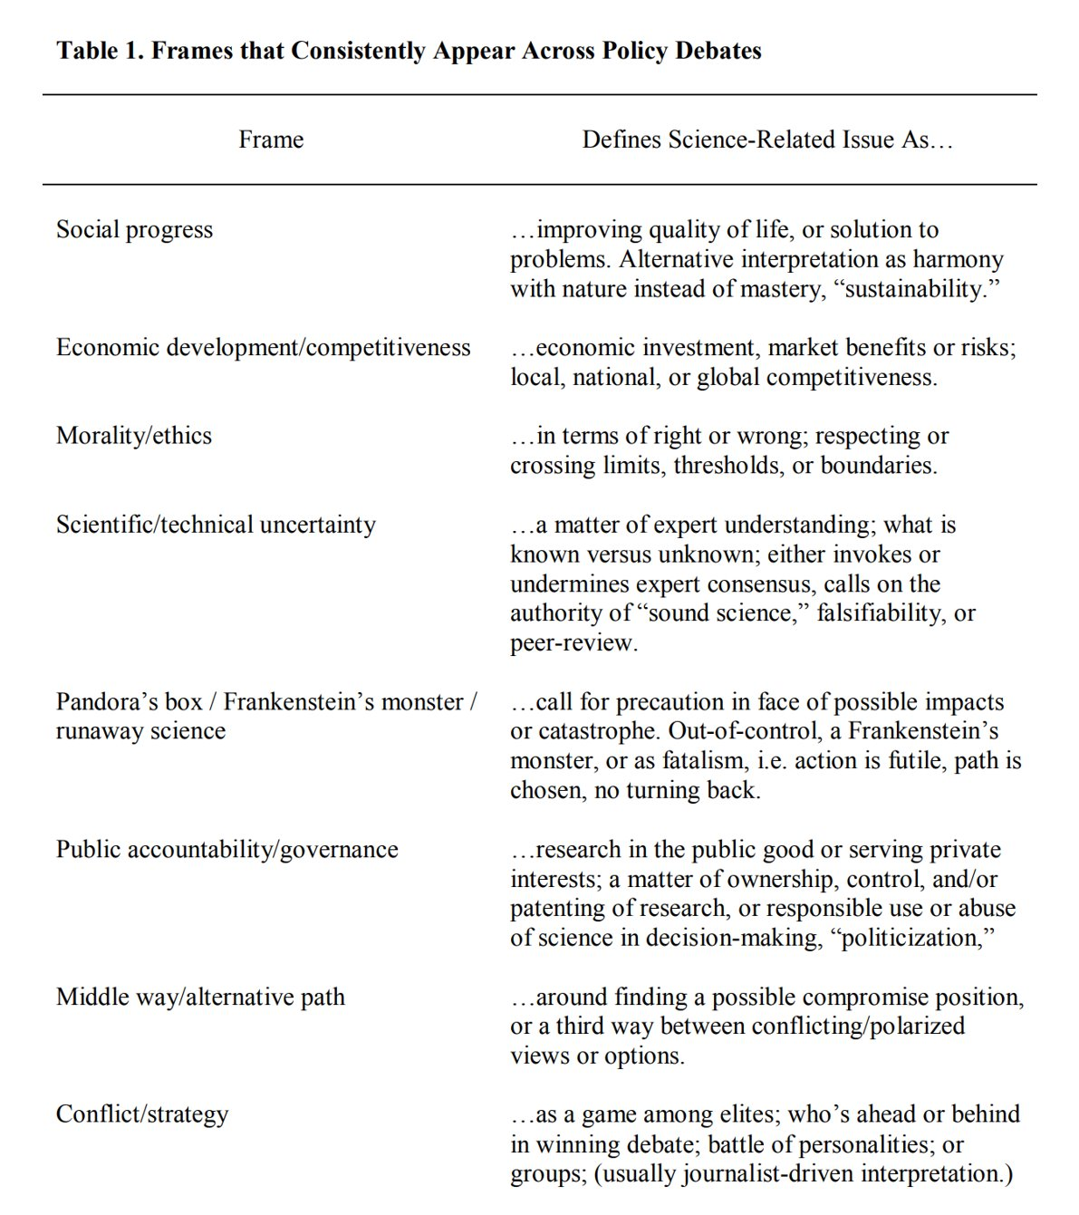
Frequently Used Science Frames
Modules → Week 3 → Quick View Handout - Table of Science Frames (from Nisbet, 2009)
Not inherently partisan.

Slide 7

Exemplar:
Framing Nuclear Energy
From Nisbet (2009)

Slide 8
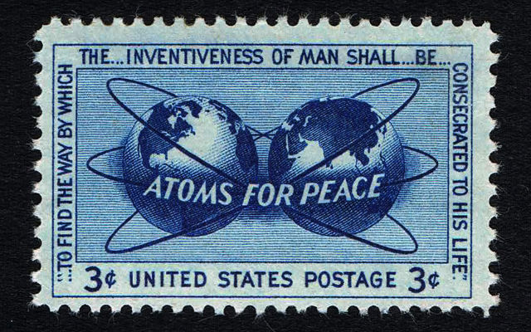
Framing Nuclear Energy
Social Progress
1950s: “Atoms for peace” and expression of power against Soviets
From Nisbet (2009)
Notes:
There are more frames that have existed throughout the decades about nuclear energy. See Framing Science PDF for details.

Slide 9
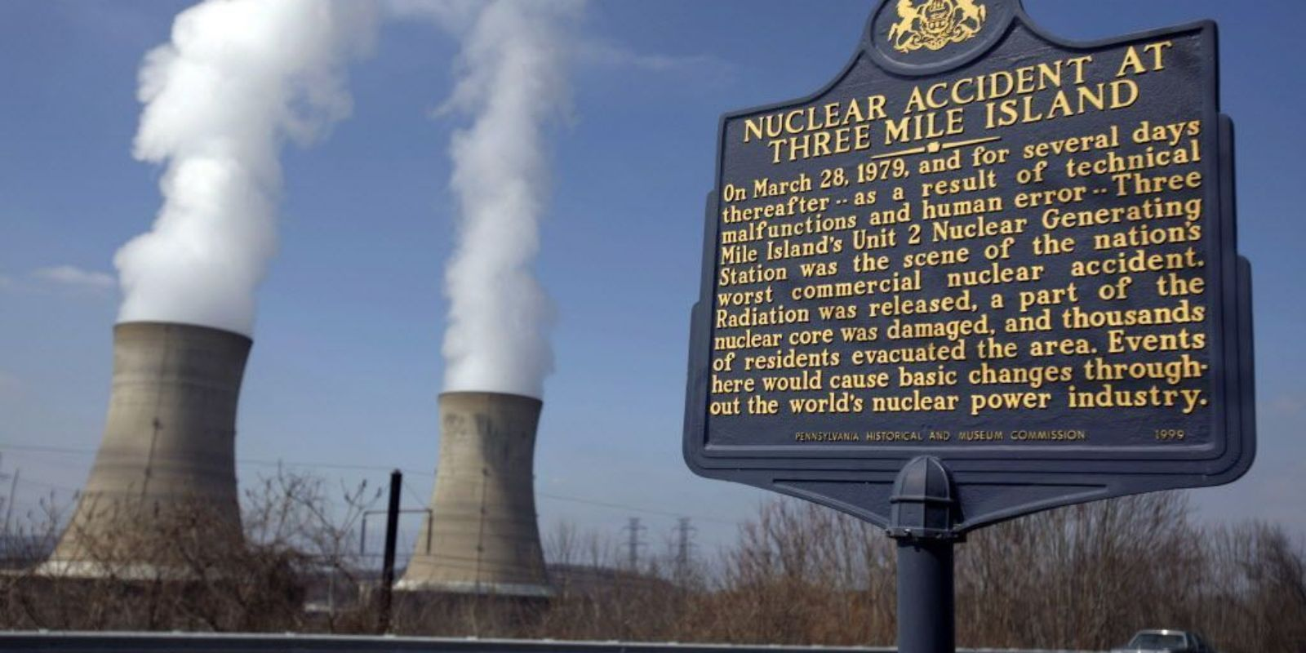
Framing Nuclear Energy
Runaway Science, public accountability
1970s and 1980s
  China Syndrome (2-minute movie trailer)
  Three Mile Island (5-minute review of what happened)
Nuclear power as too powerful for human control
Nuclear industry secrecy and incompetence
From Nisbet (2009)
Notes:
There are more frames that have existed throughout the decades about nuclear energy. See Framing Science PDF for details.

Slide 10
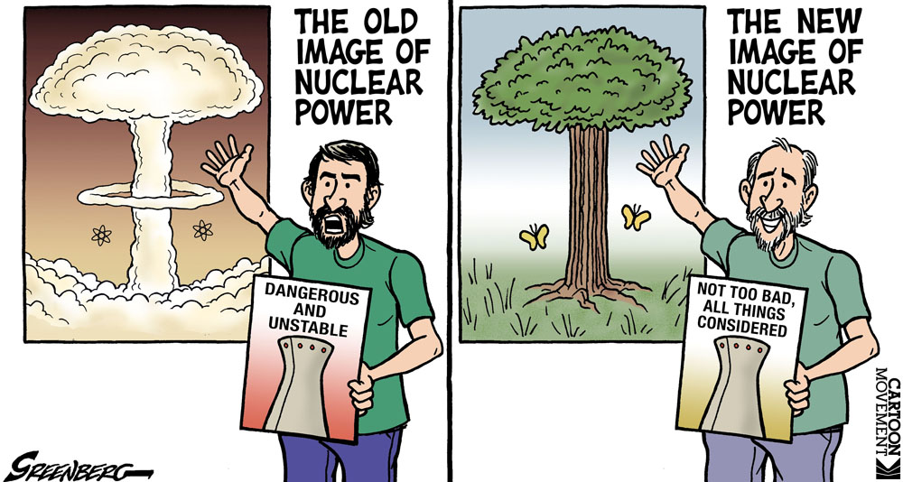
Framing Nuclear Energy
Middle Way
2000s: Nuclear energy is a middle way to energy independence and less fossil fuel consumption
From Nisbet (2009)
Notes:
There are more frames that have existed throughout the decades about nuclear energy. See Framing Science PDF for details.

Slide 11
Summary slide of Framing Nuclear Energy
Social Progress
Runaway Science, public accountability
Middle Way
1950s: “Atoms for peace” and expression of power against Soviets
1970s and 1980s
  China Syndrome
  Three Mile Island
Nuclear power as too powerful for human control
Nuclear industry secrecy and incompetence
2000s: Nuclear energy is a middle way to energy independence and less fossil fuel consumption
From Nisbet (2009)
Notes:
There are more frames that have existed throughout the decades about nuclear energy. See Framing Science PDF for details.

Slide 12

Short-Write for Week 3, Video 1
Identifying Frames In Science News
Issue: Artificial Intelligence
Goal: Increase media literacy by practicing frame identification
First, watch an 8-minute video summary of AI
Next, you will carefully read a brief Wired news article about AI and analyze the article for the presence of each of the 8 frames.
See WyoCourses for the full short-write instructions.

Slide 13


Week 3, Video 2
Frames, Partisanship, and Science

Slide 14
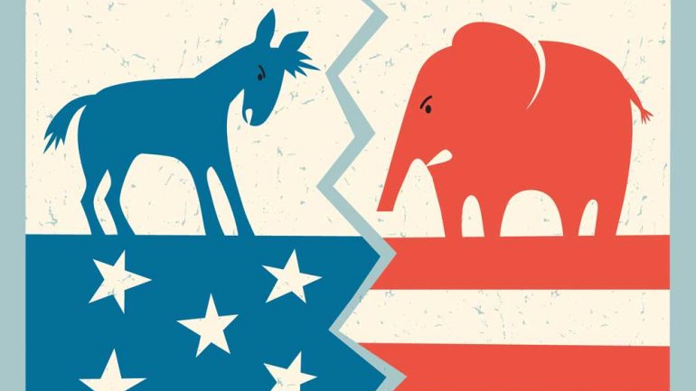
Frames and Partisanship
Sometimes, partisans agree on a specific frame for an issue.
But partisans may not agree on a specific framing application (e.g., focus of frame, positive or negative tone)

Slide 15
Frequently Used Science Frames
Modules → Week 3 → Quick View Handout - Table of Science Frames (from Nisbet, 2009)
Not inherently partisan.

Slide 16
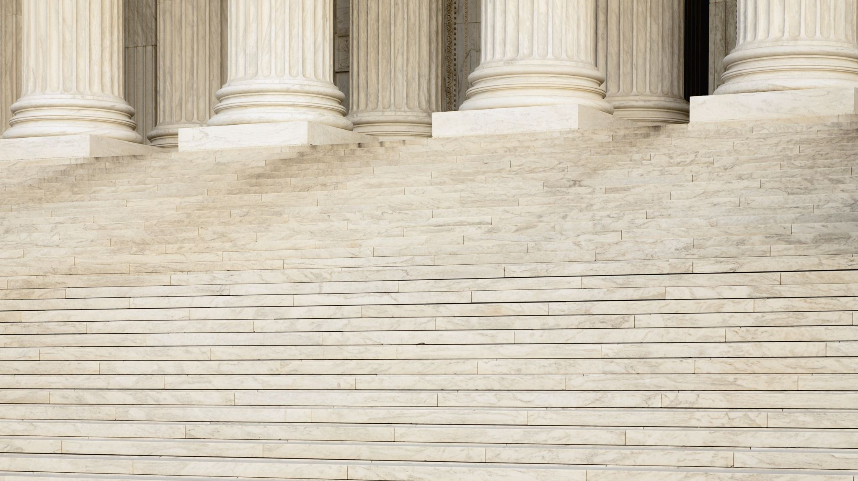
Let’s Back Up A Minute
Liberal and conservative ideology

Slide 17
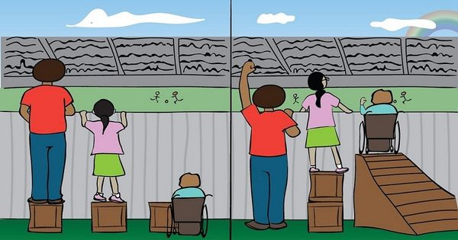
Liberal Political Ideology
Favors government action to achieve equal opportunity and equity for all.
Favors government regulation and oversight over limited government.
Supports progressive proposals for social change that may challenge tradition
Equality
Equity

Slide 18

Conservative Political Ideology
Favors personal responsibility, limited government, free markets, and individual liberty.
Favors tradition in the sense of various religious, cultural, or nationally-defined beliefs and customs in the face of external forces for change
Role of government should be to provide people the freedom necessary to pursue their own goals.
Wyoming Gov. Mark Gordon waited until December to sign a statewide mask mandate, in part, because he does not want government mandates to accomplish his goals of protecting public health.

Slide 19
Side-by-Side Comparison
Liberal Political Ideology
Conservative Political Ideology
Favors government action to achieve equal opportunity and equity for all.
Favors government regulation and oversight over limited government.
Supports progressive proposals for social change that may challenge tradition
Favors personal responsibility, limited government, free markets, and individual liberty.
Favors tradition in the sense of various religious, cultural, or nationally-defined beliefs and customs in the face of external forces for change
Role of government should be to provide people the freedom necessary to pursue their own goals.
Note: We all have good intentions and want the best for our nation. We don’t always agree on how to achieve our goals.

Slide 20

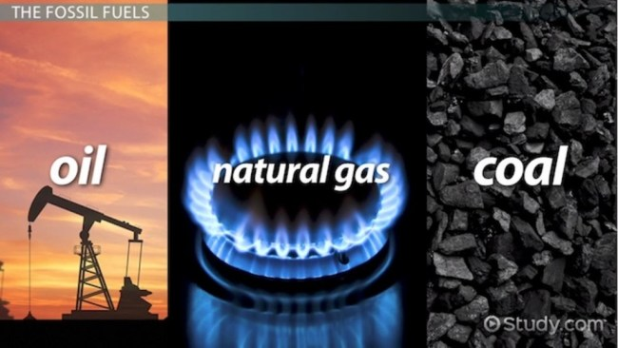
When partisans agree on the frame, but not the framing application
Example: Climate Change As Described By An Economic Development / Competitiveness Frame
Liberals highlight economic gains of clean energy innovation
Conservatives highlight economic strength and reliability of fossil fuels
From Nisbet (2009)

Slide 21
Frames and Partisanship
Of course, sometimes partisans completely disagree about the frame.

Slide 22
Frequently Used Science Frames
Modules → Week 3 → Quick View Handout - Table of Science Frames (from Nisbet, 2009)
Not inherently partisan.

Slide 23
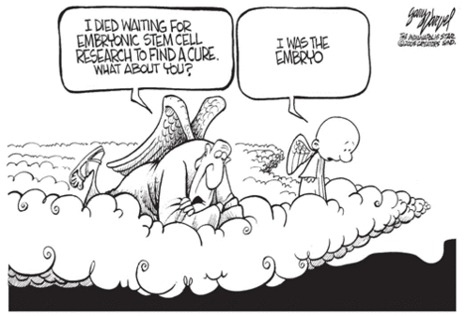
When partisans Do not agree on the frame
Example of frame disagreement:
2000s: Should federal money go to stem cell research?
Timeline of issue
What frames are applied in this political cartoon?
What frame do conservative vs. liberals apply?

Slide 24

Week 3, Video 3
When Do Frames Impact Us?

Slide 25

When Do Frames Impact Us?
When the issue is novel or new, we are more easily impacted by its framing.

Slide 26
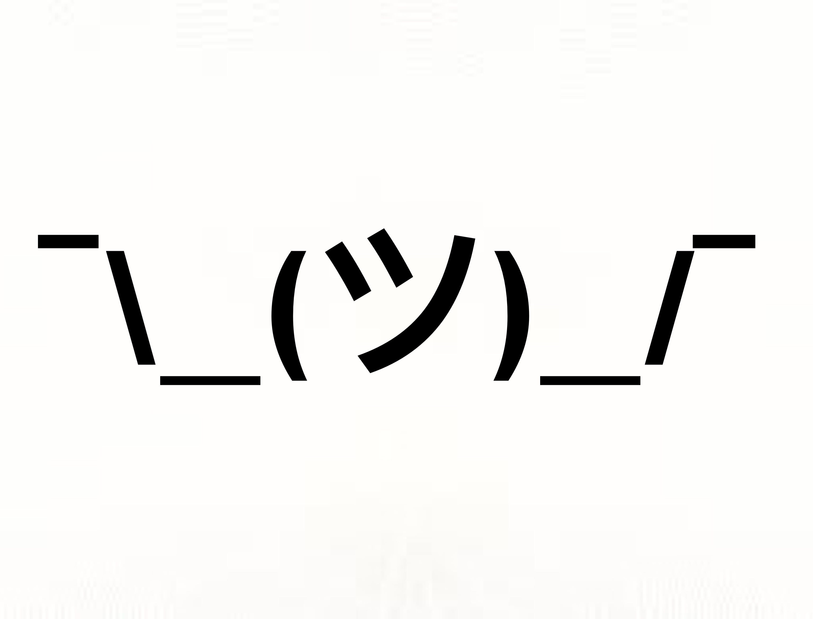
When Do Frames Impact Us?
When someone is more undecided, moderate, uninterested, ambivalent, or not elaborating on the issue, we are more easily swayed by framing.

Slide 27
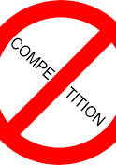
When Do Frames Impact Us?
When there is no competition for a particular frame, we tend to believe that frame.

Slide 28

When Do Frames Impact Us?
When the frame is consistent with our values, we believe that particular frame more.

Slide 29



When Do Frames Impact Us?
When our political identities are activated, we are more heavily influenced by our in-group’s framing of the issue.
From Druckman & Lupia (2017)

Slide 30

When Do Frames Impact Us?
When political conflict is emphasized, we retreat to believing our in-group’s framing of the issue.
From Druckman & Lupia (2017)

Slide 31

The Danger of the conflict frame:
Politization of Science
Exploiting and mischaracterizing the inevitable uncertainty that comes with science to overemphasize doubt and dismiss/minimize the scientific evidence.
Results in questioning of scientific evidence.
“I don’t know what to believe.”
From Druckman & Lupia (2017)

Slide 32

Counter-Frames to Politization
Cross-partisan frame and justification frame encourage careful thinking
Science consensus frames
Limitations:
  When there’s no scientific consensus
  Competition
  People don’t always care about scientific consensus and facts
From Druckman & Lupia (2017)

Slide 33

When Do Frames Impact Us?
Let’s review the key points from this “when do frames impact us?” lecture.
When we see the source as credible.
“…in the eyes of the beholder.”
Source credibility is a perception.
What enhances source credibility with frames?
Seeing commonality and benefits to listening to the source.
  Perceived commonality of interests.
  Perceived relative interests.
From Druckman & Lupia (2017)

Slide 34

Week 3, Video 4
How to influence people with frames

Slide 35
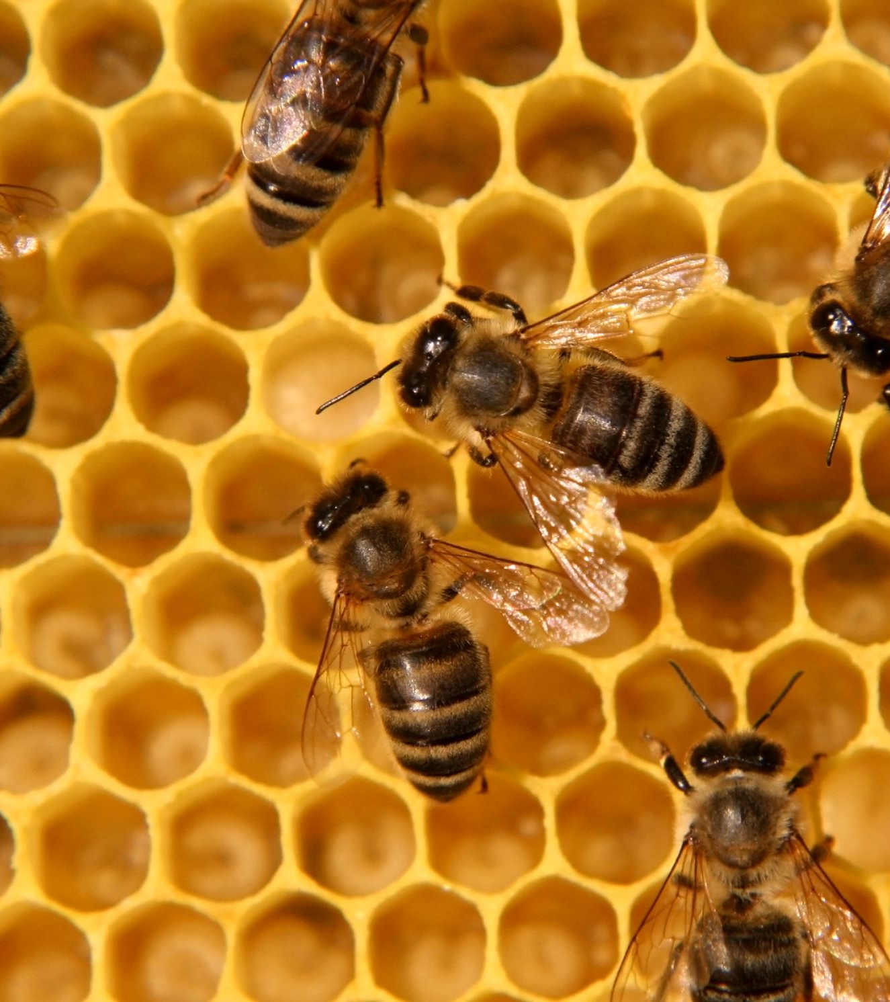
Emphasize Scientific Consensus
(Proceed with Caution)
Journalists and scientists should emphasize “hive mind” scientific consensus, if it exists.
Interpersonally, emphasize scientific consensus if the person seems to trust experts and scientists.
From Druckman & Lupia (2017)

Slide 36

Encourage Careful and Curious Thinking
Journalists can encourage careful and curious thinking by emphasizing cross-partisan frames.
Interpersonally, share stories about how you are careful and curious, and you’ve really grown.
From Druckman & Lupia (2017)

Slide 37

Increase Source Credibility
Scientists should share stories that increase source credibility, such as discussing shared values, goals, trustworthiness, and good will.
Interpersonally, you should aim for listening, understanding, perspective-taking, finding common ground, and seeking to share stories rather than persuade.
Share a story of how you changed your mind on an issue. Emphasize the frame you want.
From Druckman & Lupia (2017)

Slide 38
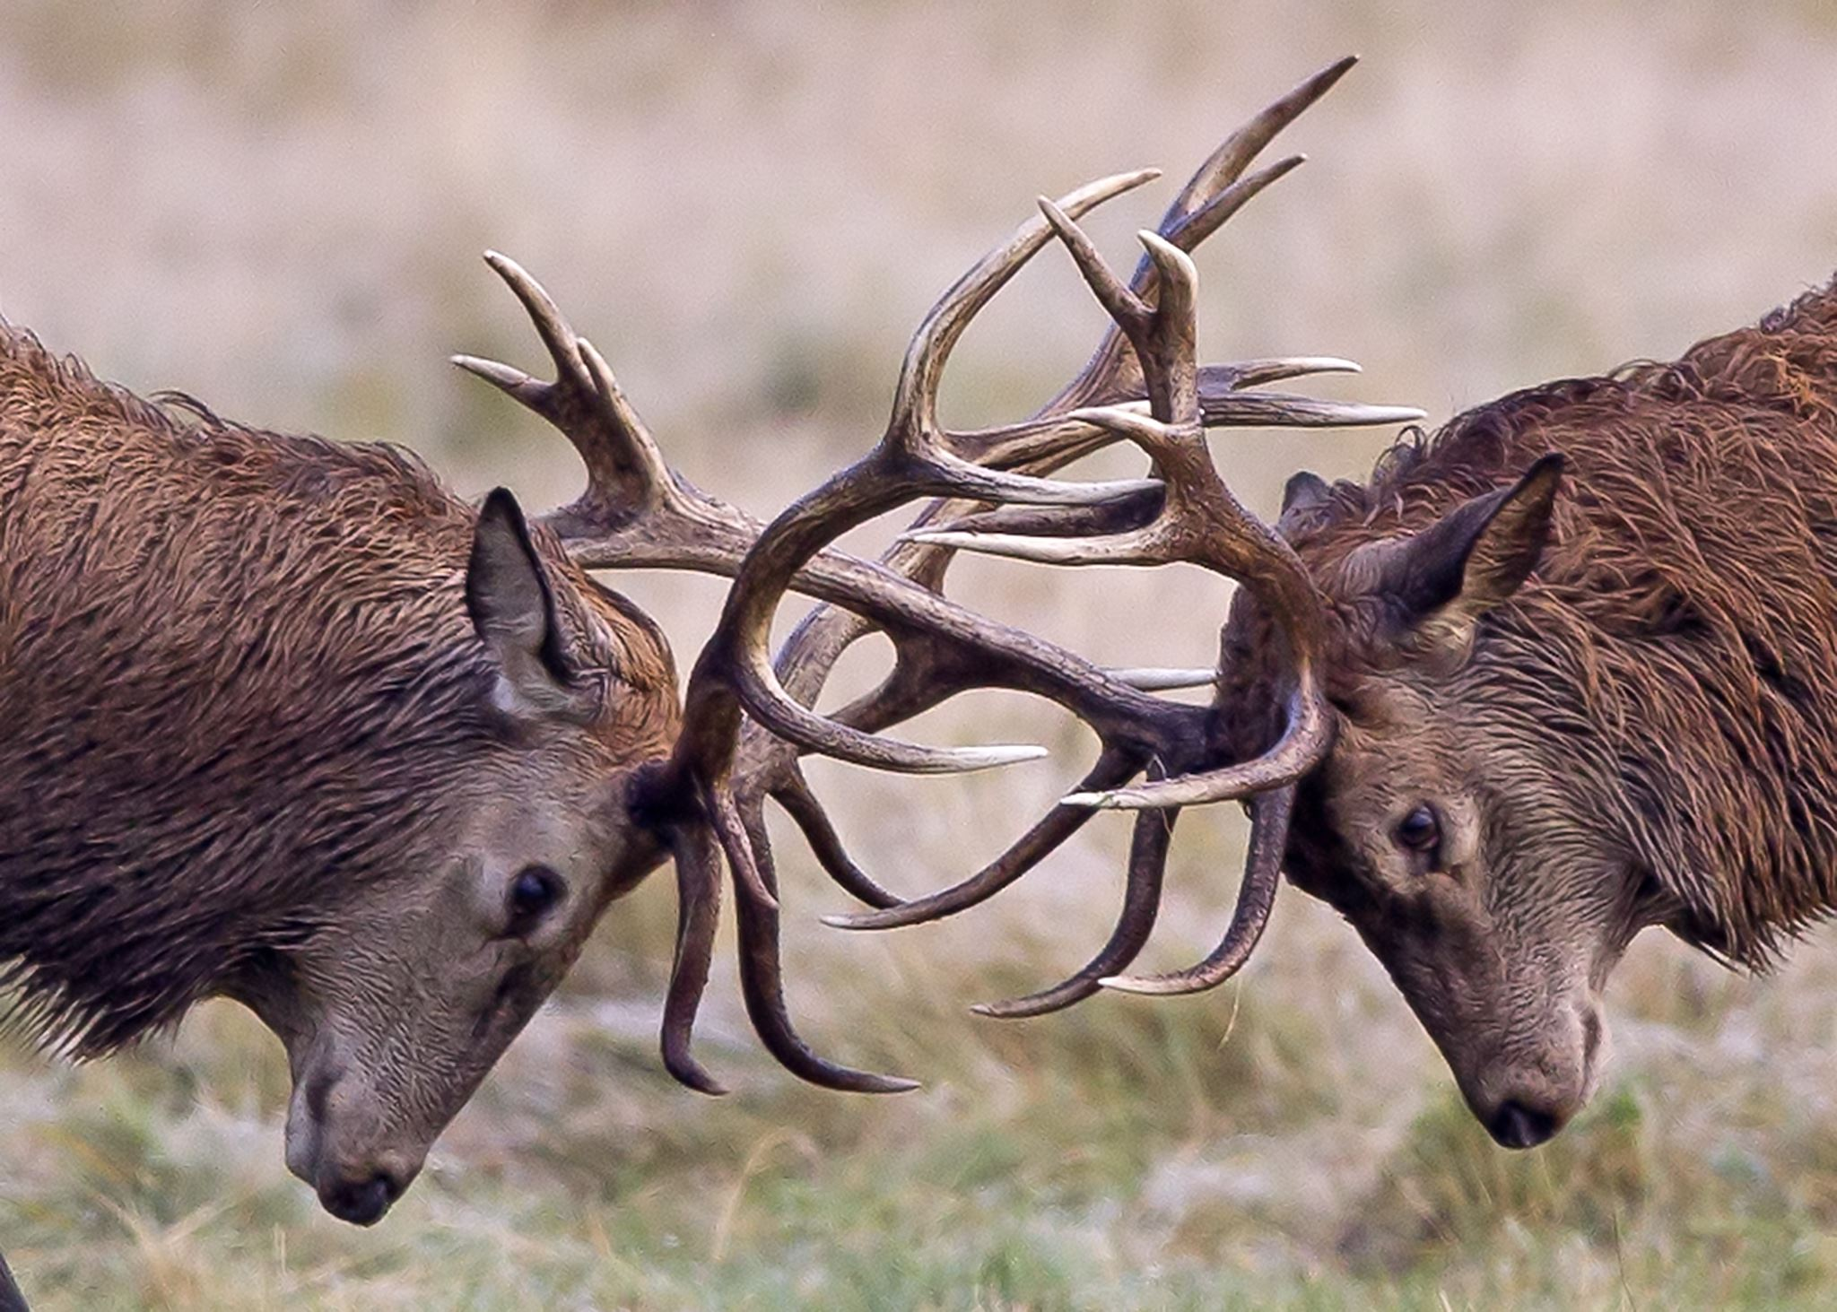
Minimize the Conflict Frame
Journalists should decrease emphasis on conflict frame and “war on science”.
Interpersonally, you should decrease focus on “winning science debates” and increase focus on sharing perspective to learn more because you’re curious.
From Besley et al. (2019)

Slide 39
Normalize the frame
Scientists should emphasize the frame (that they want to take precedence) as the social norm.
Journalists can show “everyone is doing it”.
Interpersonally, you should model the frame.
From Dooley (2020)

Slide 40
Short-Write for Week 3, Video 4
How To More Effectively Communicate about a Delicate Science Issues
Issue: COVID-19 and Masks
Goal: Synthesize relevant course content and develop practical advice for communicating about science
Read Forbes by Dooley (2020).
At this point in the pandemic, I’m confident that you have had conversations (or witnessed conversations) with someone in your life who does not wear masks to slow the spread of COVID-19.
Knowing what you know now about framing and science, science literacy and public understanding of science, and our social and political identities, let’s think about how you can move forward with more effective conversations with people who question or eschew masks.
Identify and discuss at least three distinct points/strategies/tips/considerations for how you can more effectively communicate with someone who questions or eschews masks.

