Slide 1


Scientists and Journalists
Big Picture Question:
How have scientists tried to gain influence over the public narratives around science? And how much scientists and journalists differ in their science communication goals?
Week 4, Video 1

Slide 2
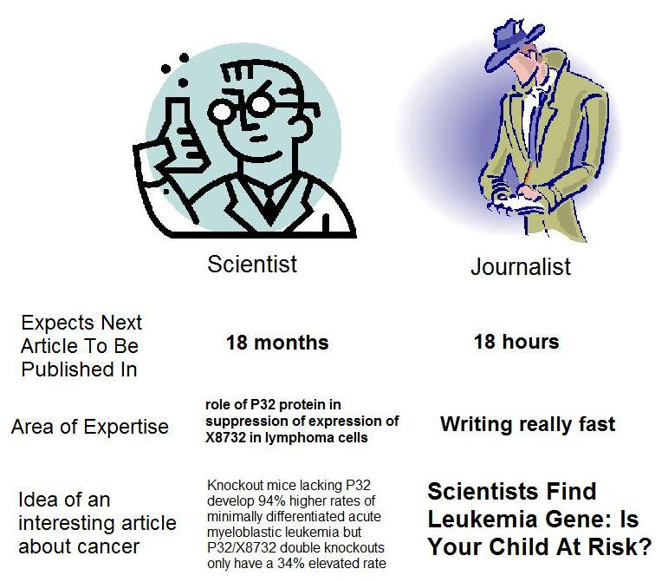

Communication and Cultural Gaps Between Scientists and Journalists
What problems do these gaps create?

Slide 3
History of Science Engagement with the Public
Scientists Directly Engage with a Participatory Public in Popularization of Science Activities
Scientists Lessen Engagement Due to Demands of Increasing Specialization and Expertise
Scientists Turn Over Construction of Popular Science Narratives to Journalists
Scientists Once Again Realize the Value of Communication and Engagement with Public
18th and19th Century
Late 19th Century and Early 20th Century
Late 20th and 21st Century
Source: Dunwoody (2015)
Scientists Even Suffer Professional Repercussions for Popularization Efforts
Scientific American Magazine and other popular science media outlets are established
Notes:
Source: Dunwoody, S. (2015). Science journalism: Prospects in the digital age. In M. Bucchi & B. Trench (Eds.), Routledge Handbook of Public Communication of Science and Technology, 2nd edition. London: Routledge.

Slide 4
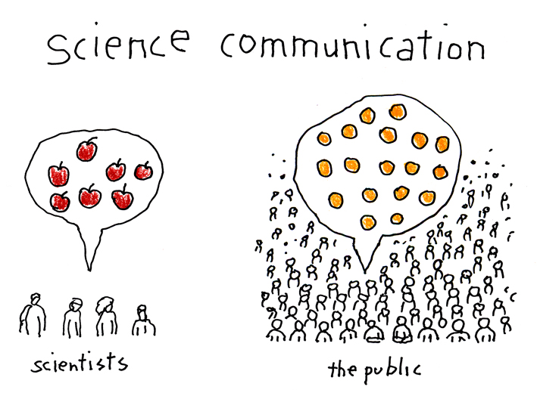
Scientists Try to Gain Control of the Conversation

Slide 5
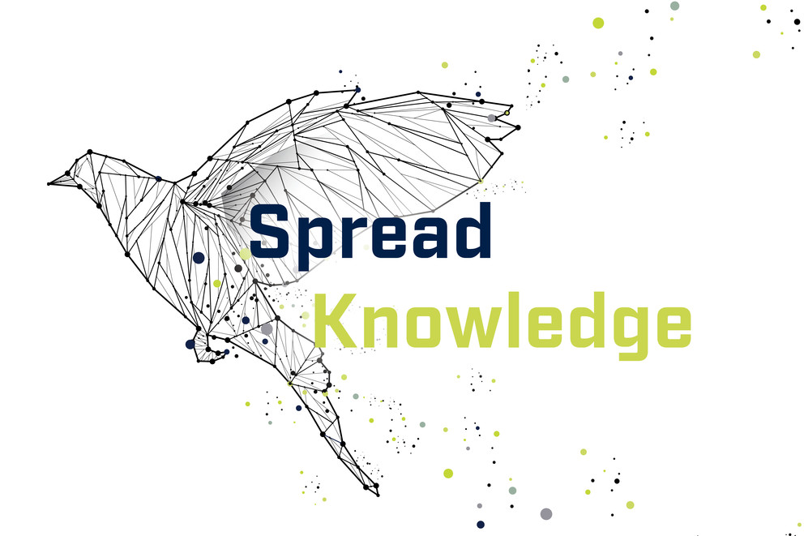

Scientists Try to Gain Control of the Conversation
What visible scientists are celebrated today?
Celebrating, Not Shunning
More recently, scientists have begun to celebrate visible scientists who engage with the public and media.
Visible scientists who get news coverage enjoy…
Other scientists citing (referencing) their work.
Other scientists thinking their work is more important.
Source: Dunwoody (2014)

Slide 6
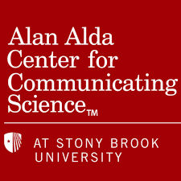

Scientists Try to Gain Control of the Conversation
Celebrating, Not Shunning
Training, workshops, and professional development opportunities abound for scientists now
Homepage is Here.
Homepage link.

Slide 7
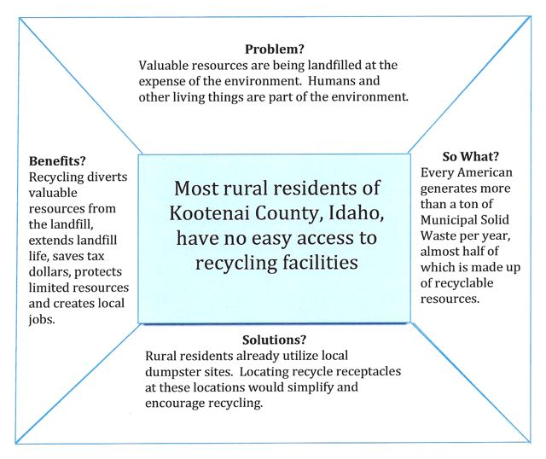
“Message Box” Technique by Compass
This helps scientists distill their message for the public.

Slide 8
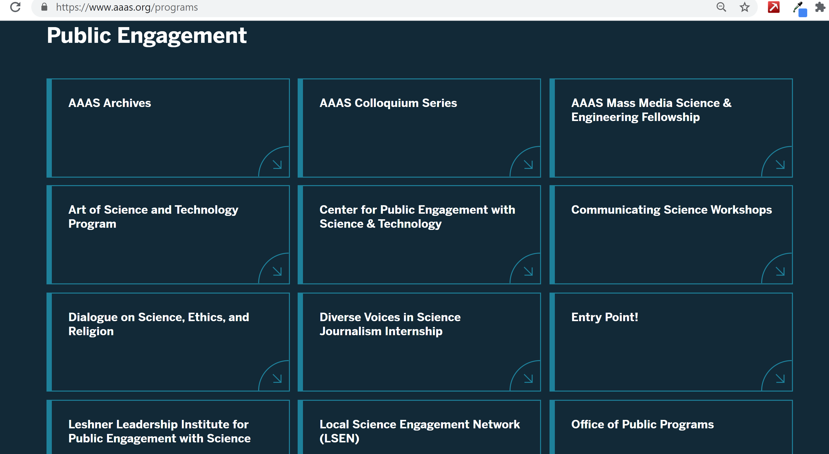
Scientists Try to Gain Control of the Conversation
Promoting, Not Hiding
Scientists active promote themselves as resources to media outlets.
Examples:
gage: 500 Women Scientists,
AAAS Public Engagement Programs
NASA: Ask a Scientist

Slide 9
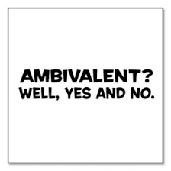
Scientists Try to Gain Control of the Conversation
A Tenuous Relationship?
Journalists are ambivalent (holding two conflicting attitudes at the same time) about these efforts:
Wary of organized large-scale science PR efforts.
Don’t want to be manipulated.
Yet, also find this information very helpful.
Need sources, ideas.

Slide 10
“Remember that you are a journalist, not a scientist. Bear in mind also that you are not a teacher, although you have to explain many things to your audience. Neither are you a literary writer, although you need to write in such a way that people will enjoy reading your stories.
Your job is to inform your audience in an effective and enjoyable way, put science news in perspective and to do "watchdog journalism," which involves analysing controversial issues. It does not matter whether you are freelance or permanent staff; or whether you are an editor-in-chief or a reporter — you are a professional journalist and you are delivering an important service to society.”
Big Picture Question:
How have scientists tried to gain influence over the public narratives around science? And, how might journalists feel about that effort?
The Job of the Science Journalist
Source: World Federation of Science Journalists
Online Training Program

Slide 11
Current Trends and Criticisms of Science Journalism
Big Picture Question:
How is science journalism operating today? And is it effective? What does ‘effective’ mean anyways?
Week 4, Video 2

Slide 12


Science Journalism:
A Profession Develops
Post WWII and going into the Space Race, the need increased for strong science journalism in society.
Professional organizations for science journalists are established.
Training programs at universities and professional organizations arise.
  WFSJ course
  Science journalism degree programs
Source: Dunwoody (2015)
Notes:
Source: Dunwoody, S. (2015). Science journalism: Prospects in the digital age. In M. Bucchi & B. Trench (Eds.), Routledge Handbook of Public Communication of Science and Technology, 2nd edition. London: Routledge.

Slide 13
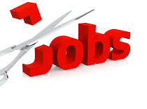
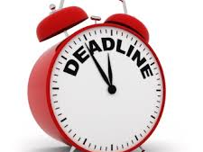
Science Journalism:
A Profession Changes
The internet happened.
Routine professional and institutional obstacles science journalists face, such as:
  deadline pressures,
  finding reliable sources,
  lack of space for science stories,
  budget and staff cuts,
  and increased commercialization
Lack of dedicated science reporters
  Denver Post has one environmental reporter.
  Nearly all of Wyoming newspapers do not have dedicated science reporters.
  Larger papers may have energy/environment reporters.
Source: Dunwoody (2015)

Slide 14
Context, Criticisms, & Challenges of Science Journalism
Think “silver bullet” stories. For example, tech stories that rave over new gadgets and AI saving the world.
Think about how anecdotal-evidence or small sample studies turn into hyped doom and gloom stories.
Science journalists have been critiqued for:
Uncritical reporting (Racine et al., 2006),
For emphasizing frames of scientific progress and economic prospect (Nisbet & Lewenstein, 2002)
For not presenting a range of expert opinion (Holtzman et al., 2005),
For having preferences toward positive messages (Cassels et al., 2003), and
For reporting unrealistic time lines and engaging in the production of a ‘‘cycle of hype’’ (Bubela et al., 2009). – Hype could be “good” (i.e., how science is great) or “bad” (i.e., how science is terrible) news stories.

Slide 15

Focus on Medicine and Health
Science news is overwhelmingly about medicine and health.
The exception is the front page of newspapers, where physics and engineering stories may be more popular.
Besides COVID-19, what other medicine/health news have you recently seen?
Source: Dunwoody (2015)
Notes:
Source: Dunwoody, S. (2015). Science journalism: Prospects in the digital age. In M. Bucchi & B. Trench (Eds.), Routledge Handbook of Public Communication of Science and Technology, 2nd edition. London: Routledge.

Slide 16
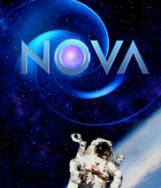
Criticisms of Science Journalism Today
Even Nova documentaries have been criticized by researchers.
Science news on TV remains scarce.
TV portrays scientists as special and distinct from others.
TV presents science as unambiguous, certain knowledge.
TV and science documentaries dramatize and anthropomorphize science
Source: Dunwoody (2015)
Notes:
Source: Dunwoody, S. (2015). Science journalism: Prospects in the digital age. In M. Bucchi & B. Trench (Eds.), Routledge Handbook of Public Communication of Science and Technology, 2nd edition. London: Routledge.

Slide 17
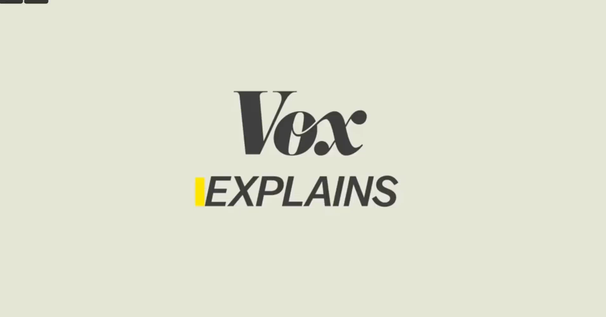
Shark Week Example of Dramatization: From Science Documentary to Fiction
What science frames are being used by Shark Week producers covering sharks?

Slide 18
Episodic vs. Thematic Frames in News
Episodic coverage dominates news, and science is no different.
Why? →
Time pressures
Difficulty of reporting process
Audience interest in conflict and novelty
Timeliness of events (e.g., “in a new study released today…”)
These trends are heightened in TV news production.
Episodic Framing:
  Focus on short-term events
  Considers the “episode” but not the “series”
Thematic Framing:
  Situates events in longer-term contexts
  Considers broader social, cultural, political, economic, or scientific environment
Source: Dunwoody (2015)

Slide 19

Is This Episodic or Thematic Framing of Health News?
Disclaimer: Profanity used
Big Picture Question:
How is science journalism operating today? And is it effective?

Slide 20
Satire As An Alternative Model for Science Journalism
Week 4, Video 3
Big Picture Question: What are the pros and cons of satire as another way to communicate about science?

Slide 21


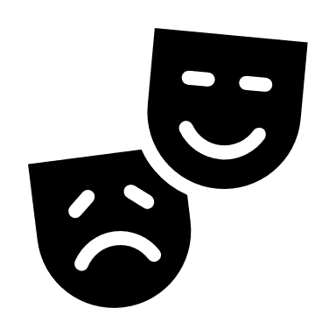
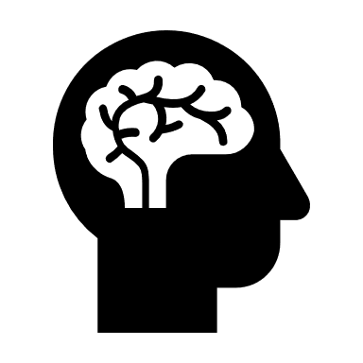
The Value of Satire
Satire is a “mix of genres”:
Comedy
Tragedy
News
Persuasion
Education

Slide 22
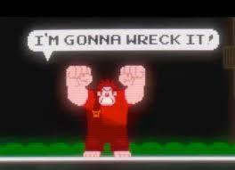
The Value of Satire
Satire as deconstructing institutions.

Slide 23
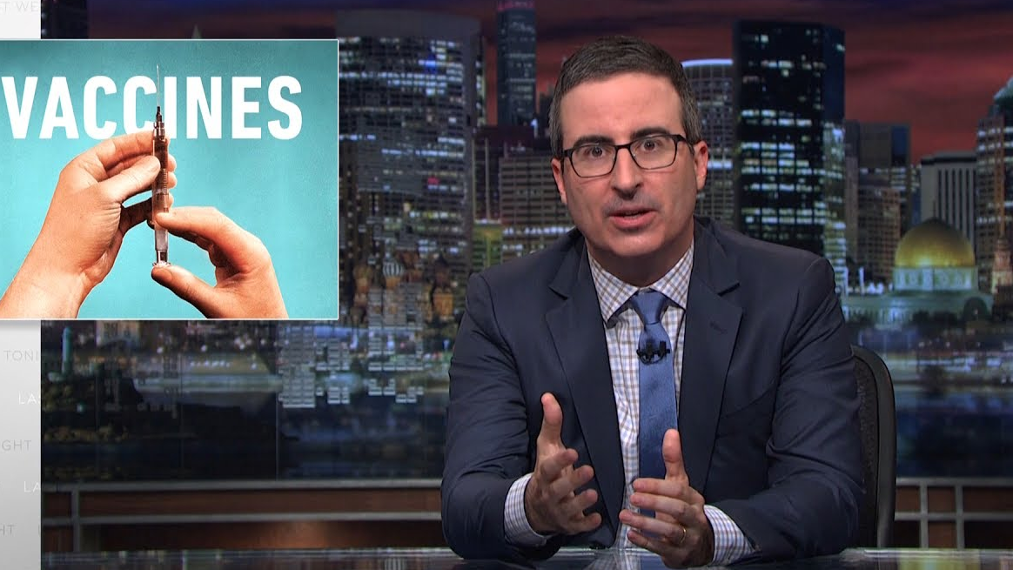
The Value of Satire
Satire can provide entertaining, yet informative, thematic framing of science.
Source: Feldman (2017)

Slide 24
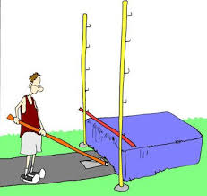
The Value of Satire
Satire lowers the bar for understanding and engaging with complex science topics.
Source: Feldman (2017)

Slide 25

The Value of Satire
Satire can create community and identity.
Source: Feldman (2017)

Slide 26
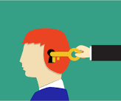
The Value of Satire
Satire can disrupt counterarguing and encourage persuasion via message discounting or reduction in mental resources.
Source: Feldman (2017)

Slide 27
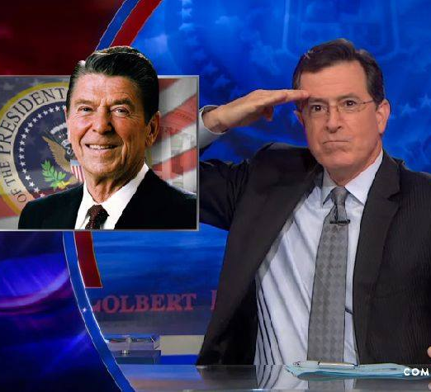
The Trouble With Satire
Sometimes, audience misreads/misinterprets satire (explicit vs. implicit; overt vs. covert).
Tendency to “see what you want to see”.
Source: Feldman (2017)

Slide 28
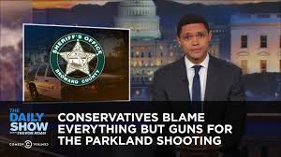
The Trouble With Satire
Satire can alienate those who feel mocked (generally conservatives and Republicans).
Satire can reduce tolerance of dissenting views among those who agree with satirist.
Satire is more appealing to liberals than conservatives.
Let’s learn more about the psychological reasons why satire is more appealing to liberals than conservatives by watching or reading the transcript of this Ted talk.

Slide 29



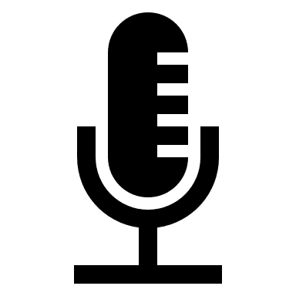
The Trouble With Satire
Satire will never reach as many people than traditional news.
There is still a lot that we don’t know about satire and science.
Big Picture Question: What are the pros and cons of satire as another way to communicate about science?
Source: Feldman (2017)

Slide 30
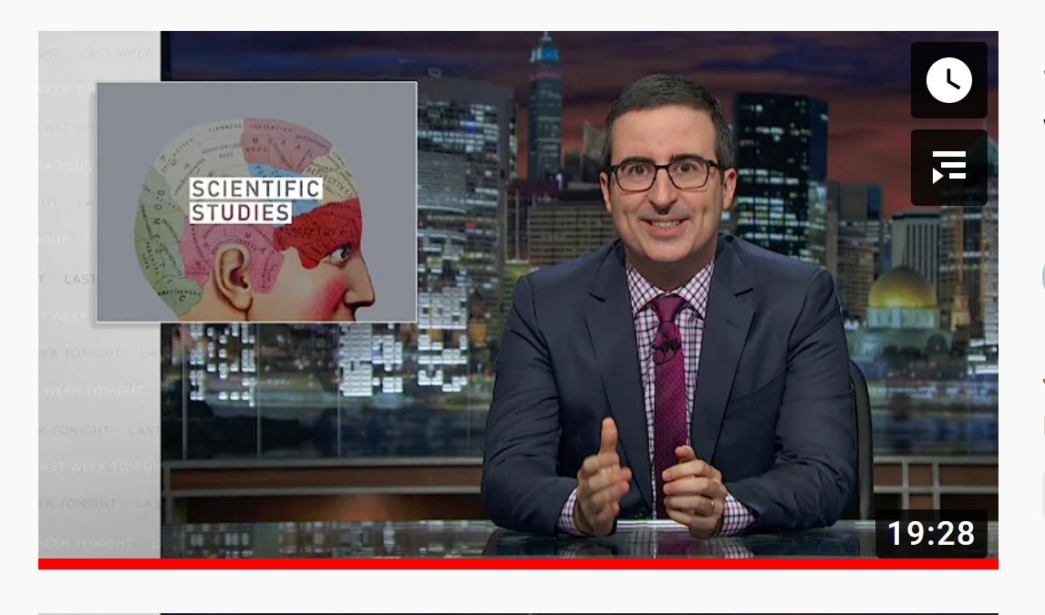
Short-Write for Week 4, Video 3
Satire Covers Science
Issue: Quality of Science Journalism in America
Goal: Recognize and identify specific criticisms about common practices in science journalism
Length: About 1 to 1.5 pages, double-spaced
Tip: Remember to integrate references to course readings or lecture videos.
Identify and briefly describe each unique criticism that John Oliver discusses about science journalism.
Discuss which two or three criticisms you find most pressing and concerning as a science news consumer.
Discuss to what extent you think Jon Oliver's satire is damaging itself to the public dialogue surrounding science.

Slide 31
Improving Science Journalism
Week 4, Video 4
Big Picture Question:
What are solutions to these problems with science journalism that we’ve identified?

Slide 32
Consider New Models of Knowledge-Based Journalism
Source: Nisbet & Fahy (2017)
Traditional role of science reporting should be supplemented by these knowledge-based journalistic goals:
Dialogue Brokers
Foster discussion among diverse stakeholders using social media tools; Encourage audiences to recognize the gray areas and different perspectives.
Knowledge Brokers
Knowledge as process; Tell readers how and why scientific research was done; Pose alternative interpretations; Draw connections among complex problems.
Policy Brokers
Counter group-think and diffuse polarization in science controversies by expanding the range of policy options and technologies under consideration by the public.
Notes:
Source: Nisbet & Fahy (2017). New models of knowledge-based journalism. In K. H. Jamieson, D. M. Kahan, & D. A. Scheufele (Eds.), The Oxford handbook of the science of science communication.

Slide 33
Encourage Journalists to Think Carefully About Their Approach to the Science Story
Traditional models
Non-Traditional models
Main Focus: Information Delivery
Science is the legitimizing form of knowledge.
Science is active.
Public is passive.
Journalists “rearrange” science to communicate it.
Main focus: Public Engagement
Science is equal to other forms of knowledge.
Science and public are actively engaged to enhance deliberative and democratic debate.
Source: Secko et al. (2013)

Slide 34
Two Major Approaches
Traditional models
Non-Traditional models
Science Literacy Model
Contextual
Model
Lay Expertise Model
Public Participation
Source: Secko et al. (2013)

Slide 35
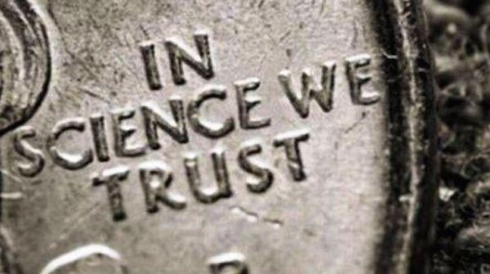
1. Science Literacy Model
Goal? Increase understanding of science among public
Role of science? As fixed, knowledgeable, and certain
Journalism’s role? As a “translator” of science using objective reporting; may emphasize “wow” factor to tell a story
Example: One dose of COVID-19 vaccine provokes strong immune response in those previously infected. By BAR-ILAN UNIVERSITY.
Source: Secko et al. (2013)

Slide 36
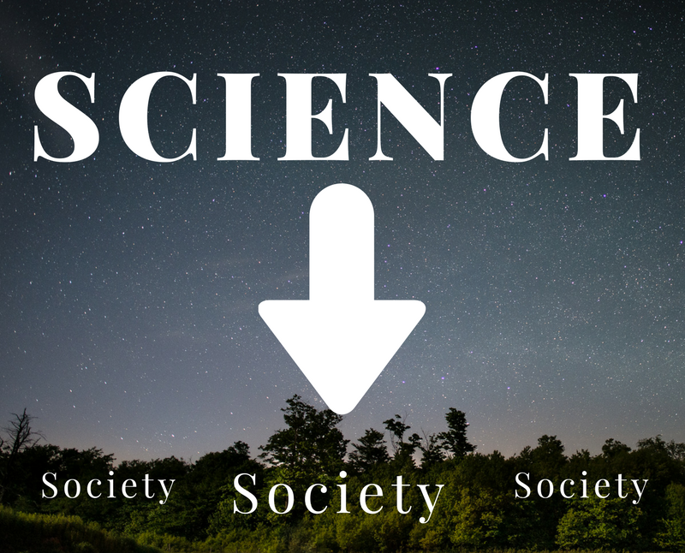
2. Contextual Model
Goal? Deliver top-down info., acknowledge science means different things to different groups
Role of science? Science is still above society (society as “concerned spectators”)
Journalism’s role? Science is still “translated”, journalists inform audience about science as it relates to them
Example: Is It Safe to Delay a Second COVID Vaccine Dose? By Scientific American
Source: Secko et al. (2013)

Slide 37
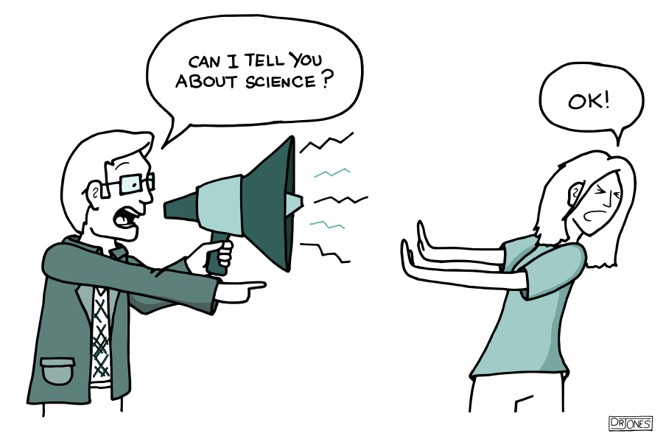
Criticisms of Traditional Models
Lack of context and failure to connect science to personal relevance
Uneven power relations between scientists and the audiences
Ignorance of other forms of non-scientific knowledge
Source: Secko et al. (2013)

Slide 38
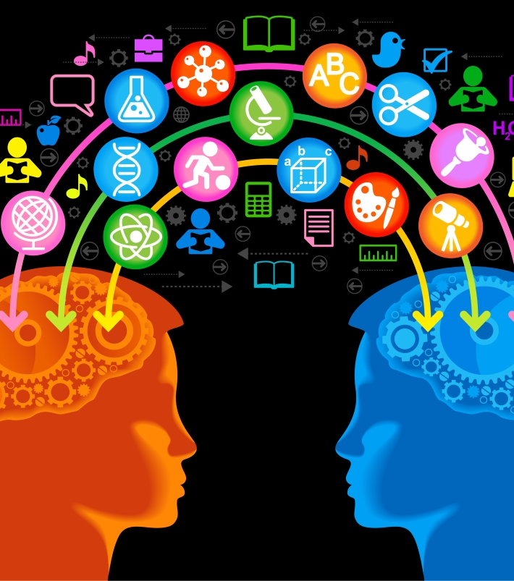
3. Lay-Expertise Model
Goal? Empower communities by incorporating local knowledge into science engagement
Why? Local knowledge is equal in value to scientific knowledge; science can learn from communities
Role of science? Science is uncertain and limited; other sources of knowledge are needed
Journalism’s role? Journalists should report on what scientific questions laypeople want answered
Example: Why 'I can't breathe' is resonating with environmental justice activists. By NBC News.
Source: Secko et al. (2013)

Slide 39
4. Public Participation Model
Scientists
Gov.
Publics
Journalists
Goal? Actively engage stakeholders
Why? To improve comm. and trust among stakeholders
Role of science? Science and culture are valued as different, yet equally important.
Journalism’s role? Journalists should focus on the processes behind the science and include multiple stakeholder viewpoints in order to engage audiences in pluralistic debate
Example: Citizen science is booming during the pandemic. By Vox.
Source: Secko et al. (2013)

Slide 40
Criticisms of Non-Traditional Models
Non-Expert
Expert
Lay-Expert
It’s impossible to balance (equally weigh) expert, lay-expert, and non-expert scientific knowledge when decision-making.
We should not be equating non-expert knowledge with expert knowledge.
Source: Secko et al. (2013)

Slide 41

So, How Should Journalists Write Science Stories?

Slide 42
“It Depends…”
6 Criterion for Better Science Journalism

Slide 43
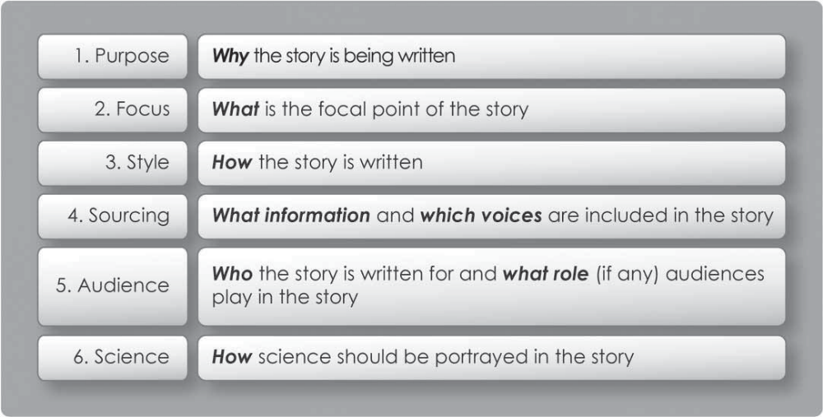
6 Criterion For Better Science Journalism
Source: Secko et al. (2013)

Slide 44
1. Is this story about simple transmission or about promoting active engagement? And, what’s the “so what”?
6 Criterion For Better Science Journalism
Source: Secko et al. (2013)

Slide 45
2. Is it based on events (episodic) or tied to broader contexts and implications of the science and choices made (thematic)?
6 Criterion For Better Science Journalism
Source: Secko et al. (2013)

Slide 46
3. Avoid jargon, write simply, use analogies and metaphors. Also think about how the science is presented in a narrative.
6 Criterion For Better Science Journalism
Source: Secko et al. (2013)

Slide 47
4. Is it Journalism of Information or Journalism of Conversation? Whose voices are legitimate?
6 Criterion For Better Science Journalism
Source: Secko et al. (2013)

Slide 48
5. Is the audience passive or active? Are you including audience’s values and interests into the story?
6 Criterion For Better Science Journalism
Source: Secko et al. (2013)

Slide 49
6. Is science portrayed as fixed and certain, or, uncertain and socially bound?
6 Criterion For Better Science Journalism
Source: Secko et al. (2013)

Slide 50
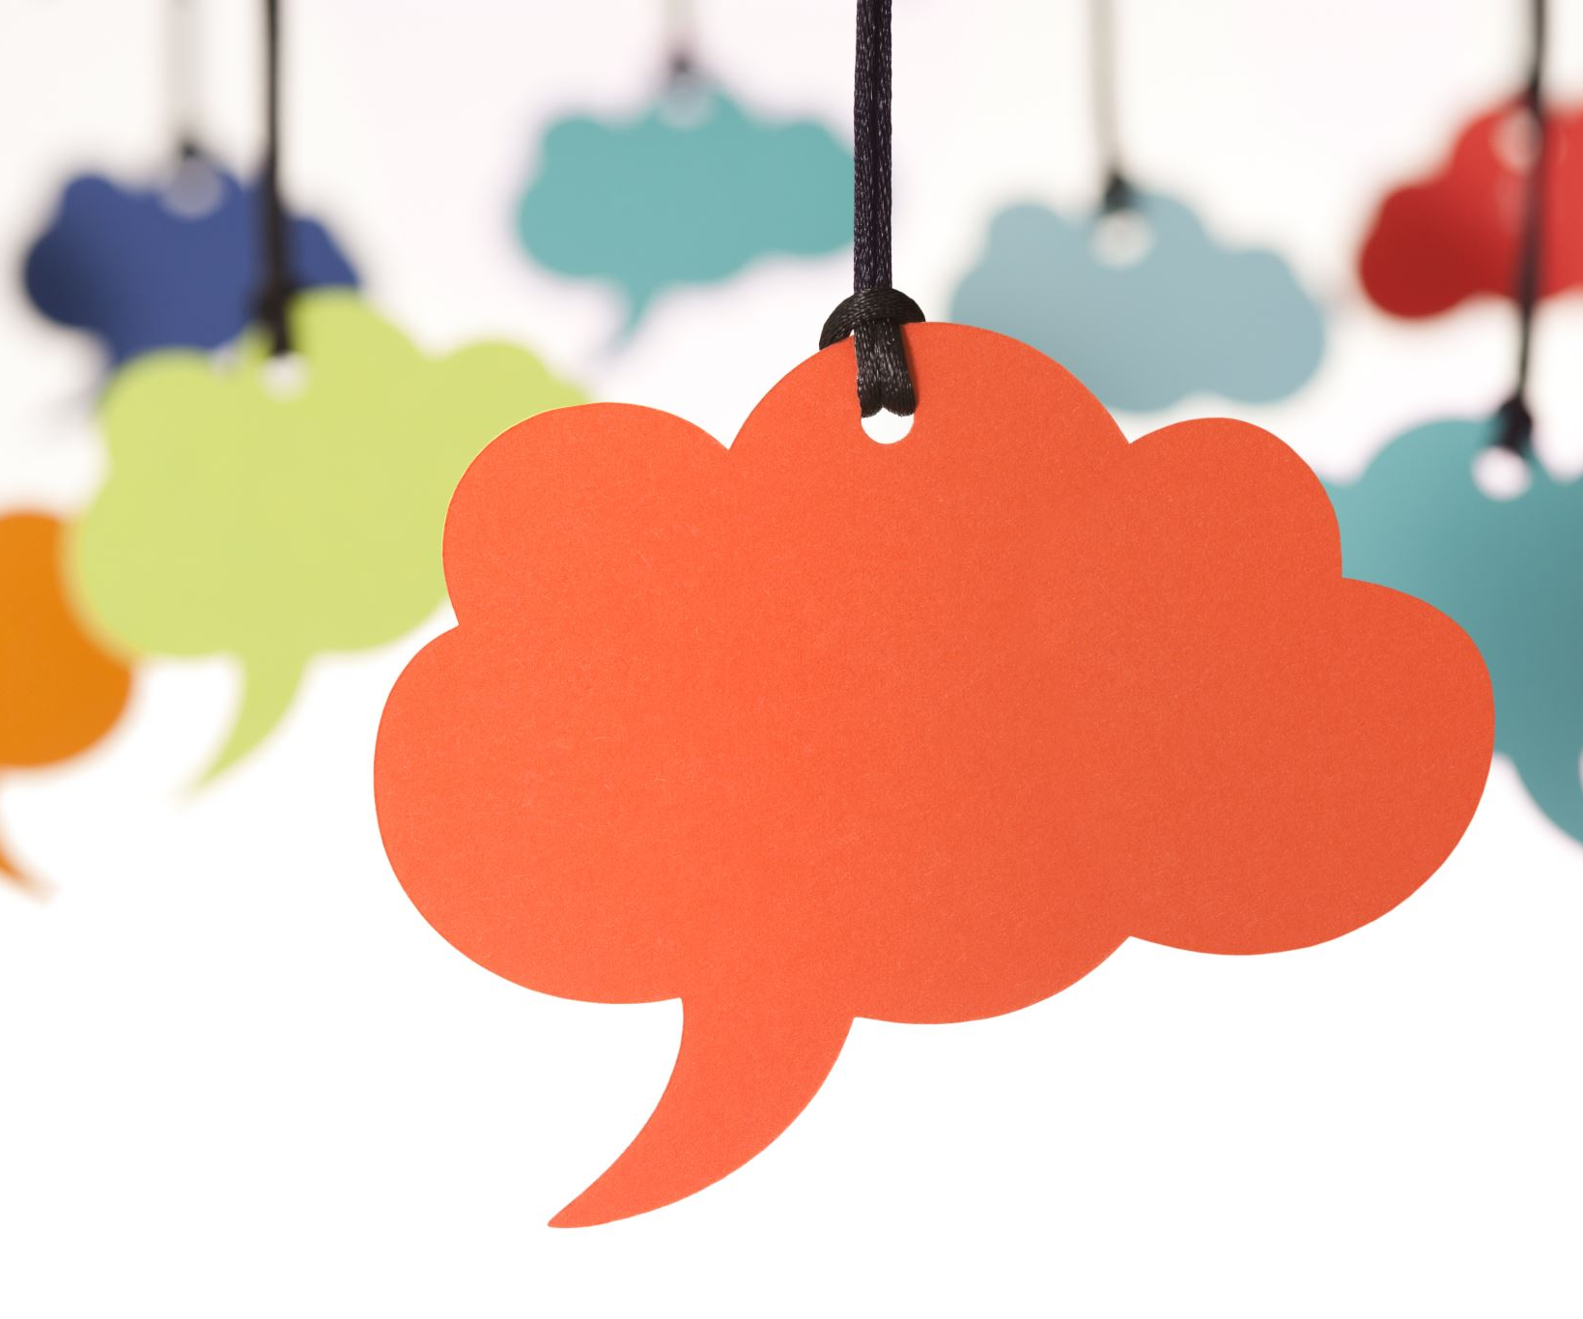
Linking the Criteria to the Models
Journalists:
  Be thoughtful of these criteria
  Be purposeful about the model you choose
  Avoid writing stories using traditional models “just because that’s the way we always do it.”
Science news consumers:
  Be thoughtful of the science news you choose
  Mix up your science news diet
  See WyoCourses for science news sources
Big Picture Question:
What are solutions to these problems with science journalism that we’ve identified?

